Slide 1
SIO 210: Southern Ocean circulation. Dynamics X: Southern Ocean L. Talley Fall, 2016
Geography:open at Drake Passage
Circulation: much more like atmosphere (no boundaries)
Creates mix of Sverdrup and non-Sverdrup balance general circulation
Antarctic Circumpolar Current
Antarctic subpolar gyres (Weddell and Ross Seas)
Water mass modification and formation:
Impacts of the ACC, sea ice (brine rejection) and widespread Ekman upwelling
Connections (inflow and outflow) with Atlantic, Pacific, Indian
READING:
DPO Chapter 13 (Southern Ocean) – selected parts
Some animations http://ryan.actualscience.net/

Slide 2
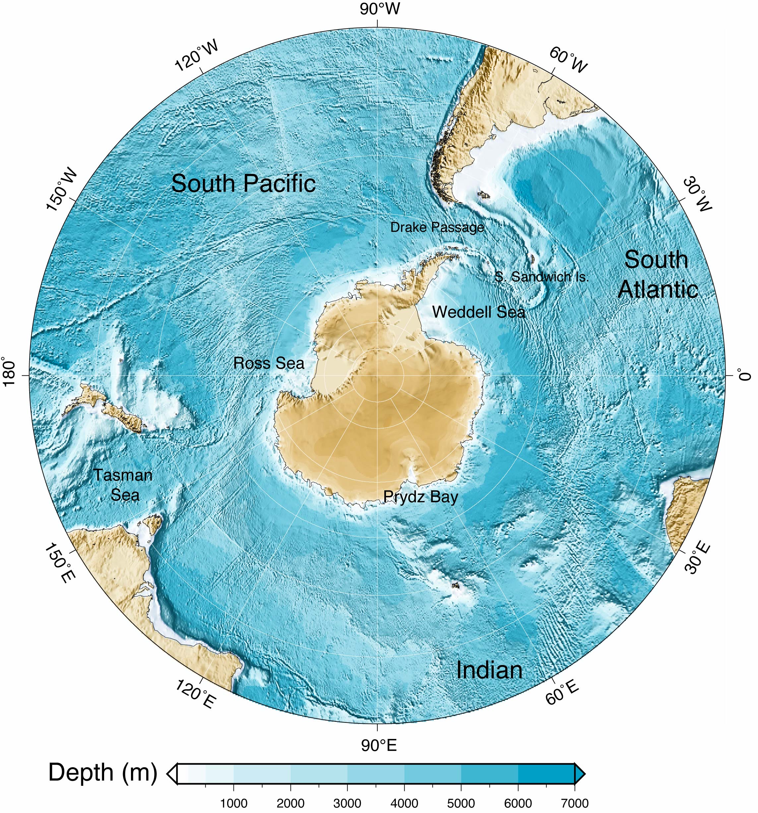
Southern Ocean geography
DPO Fig. 2.12

Slide 3
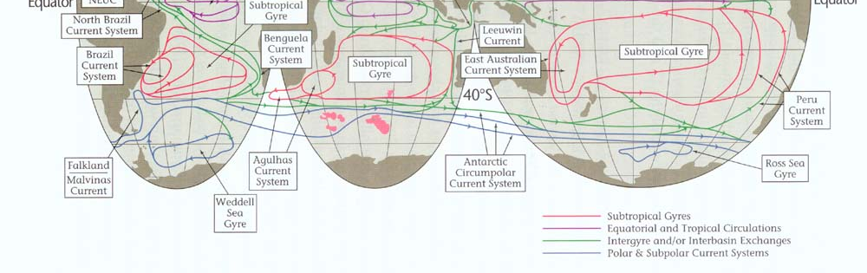
Schematic of surface circulation (Schmitz, 1995)
Weddell Sea gyre (cyclonic)
Ross Sea gyre (cyclonic)
Antarctic Circumpolar Current encircling Antarctica, starting farthest north off S. America as the Malvinas/Falkland Current, shifting southward as it moves eastward until it flows through Drake Passage
DPO Fig. 14.1

Slide 4
Dynamics: Annual mean wind stress, Ekman stress
Ekman transport
Southern Ocean westerlies are strong. (Fig. from Tomczak and Godfrey)

Slide 5
Dynamics: Ekman pumping
Westerly winds, which decrease in strength towards Antarctica and become easterlies and “katabatic” winds (very cold, continental winds)
equatorward Ekman transport, Ekman downwelling north of ACC
AND Ekman upwelling south of the maximum westerly winds
DPO Fig. 13.2

Slide 6
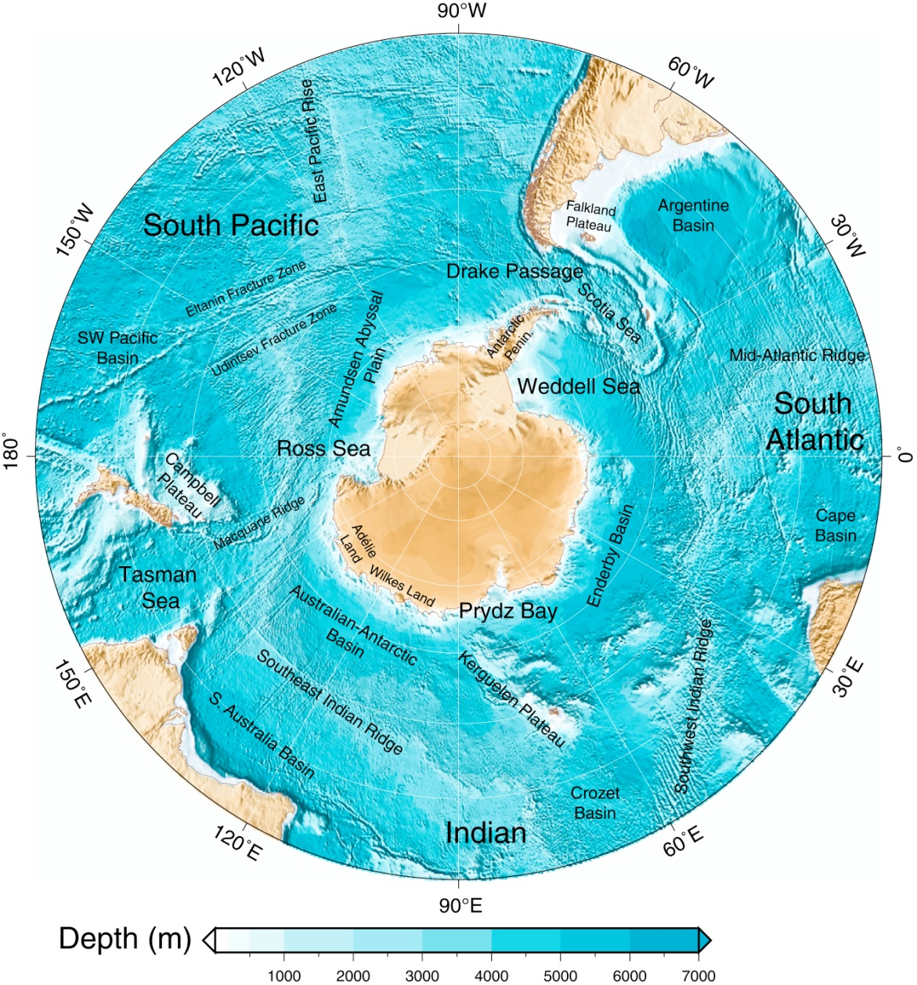
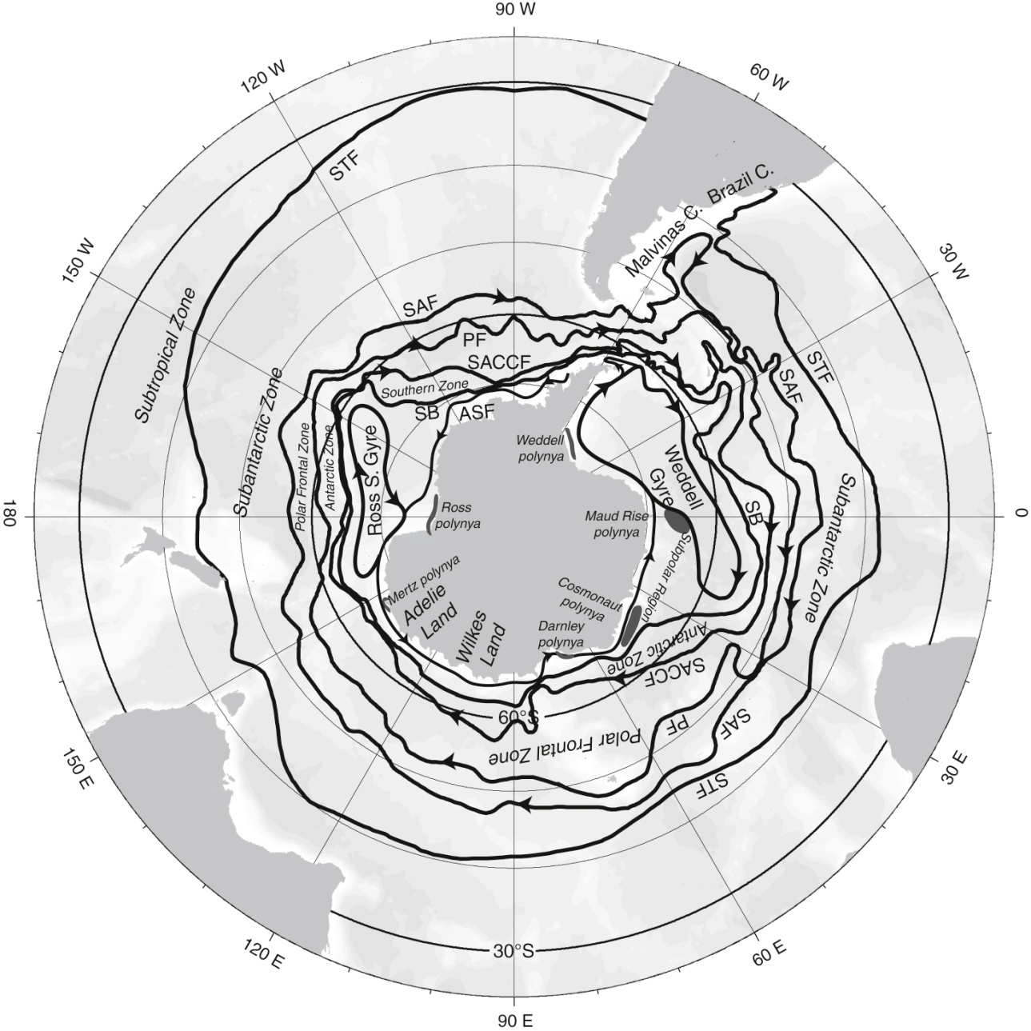
Drake Passage latitudes: bathymetry and circulation
Drake Passage is open down to about 2000 m depth.
Therefore, no western boundary from surface to 2000 m.
Deeper than 2000 m, there are numerous boundaries.
Notes:
Focus on low oxygen regions, < 60 (Keeling)

Slide 7
Dynamics: Antarctic Circumpolar Current
DPO Fig. 5.17
1. Traditional Sverdrup balance north (and also south, not shown here) of latitude of Drake Passage. Western boundary current is the Malvinas (Falkland) Current off S. America. Shift of whole ACC southwards from this location towards the east in response to Ekman upwelling.
2. BUT open Drake Passage from surface to 2000m means that Sverdrup balance does not hold throughout (no western boundary above sill depth).
ACC has additional zonal jet dynamics; outside the scope of SIO 210

Slide 8
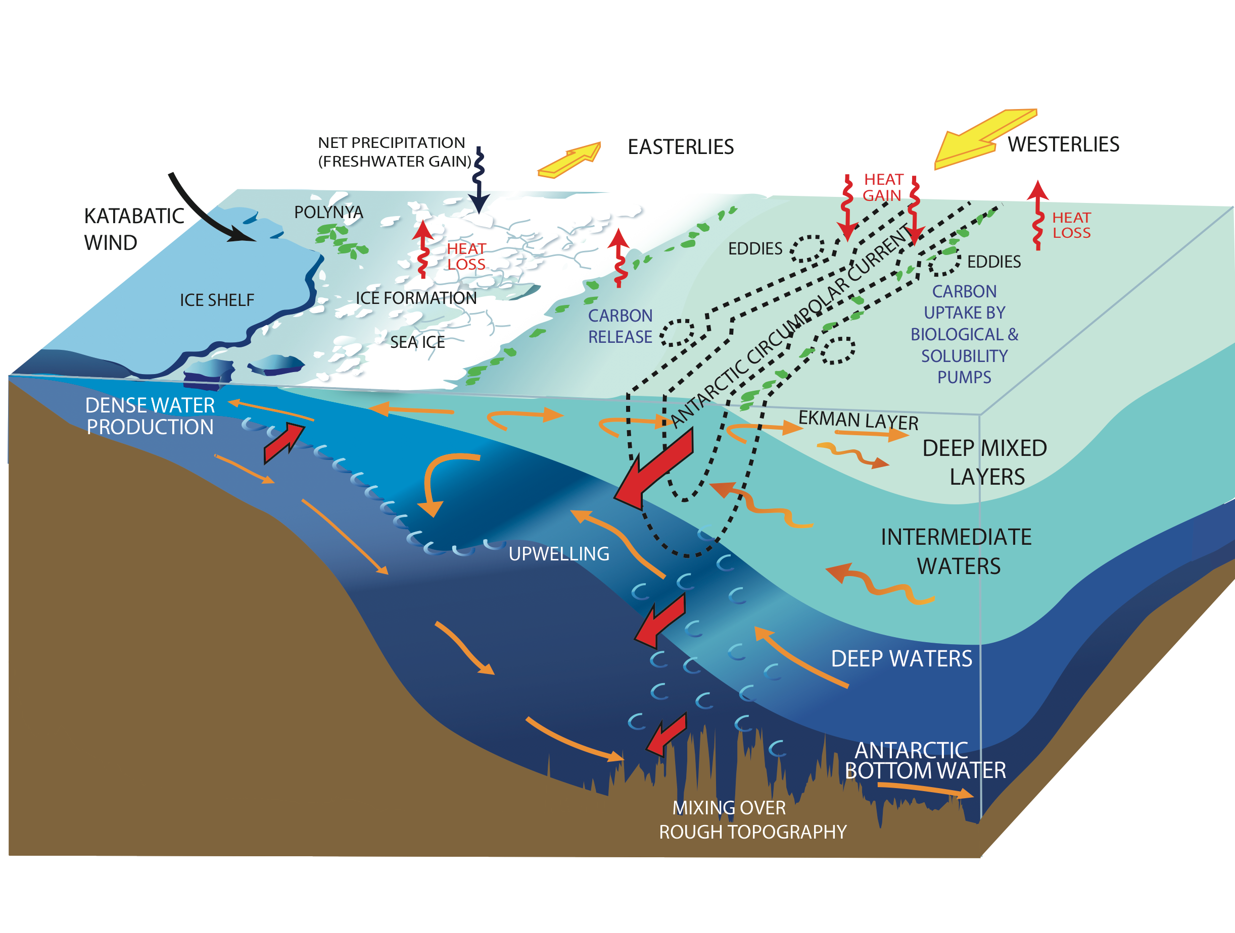
Dyamics: deep to surface upwelling
After NRC (2011)
Southern Ocean is the only place where there is direct upwelling from deep waters to the sea surface over a very large region.
Dynamically this is due to the open Drake Passage latitude band.

Slide 9
Zonally-averaged overturning circulation and processes
Winds (stress and curl) – upwelling and circulation
Air-sea heat loss and gain
Air/ice-sea freshwater fluxes (here due to ice processes)
Diapycnal mixing
[Schematic evolved from Speer et al (JPO 2000) and Olbers et al. (Ant. Science 2004)]

Slide 10
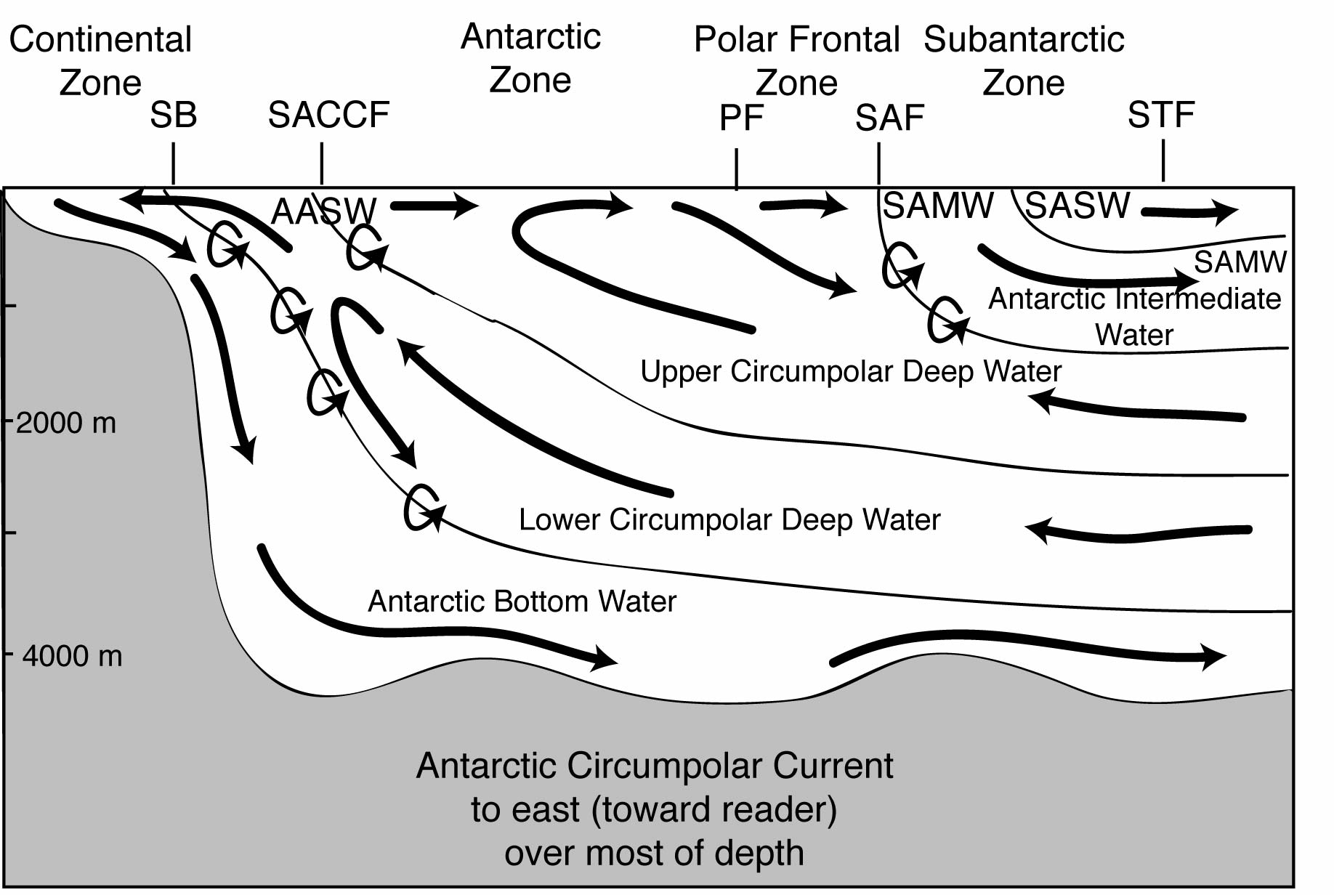
Dynamics: Ekman, upwelling, bottom water formation, eastward ACC
DPO Fig. 13.4 (after Speer et al. 2000)

Slide 11
Dynamics: Ekman, upwelling, bottom water formation, eastward ACC
http://ryan.actualscience.net/videos/

Slide 12
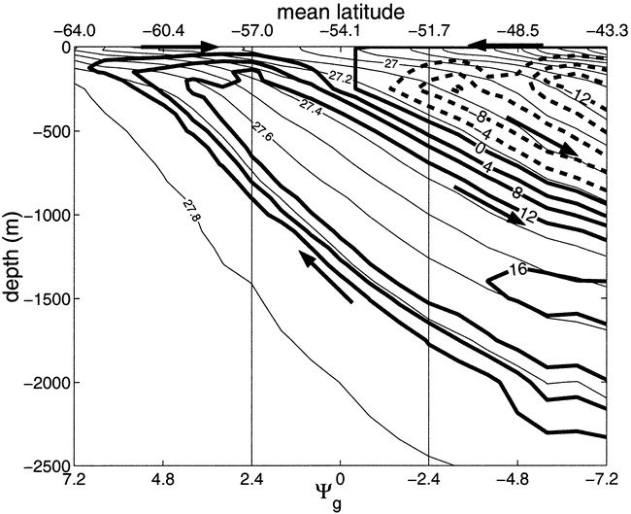
Dynamics: (more advanced) “residual circulation”
Karsten and Marshall (JPO, 2002)
The total northward flow in the surface layer is the sum of northward Ekman and southward eddy flux that tries to flatten the isopycnals (due to baroclinic instability)
(“Residual circulation” is the flow along isopycnals.)

Slide 13
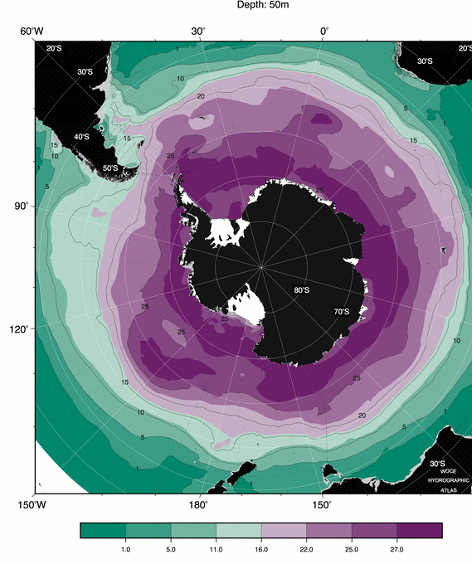
Evidence of upwelling: Near-surface nitrate
High surface values reflect upwelling.
Driven by Ekman suction.
http://woceatlas.tamu.edu
(Orsi and Whitworth, 2005)

Slide 14
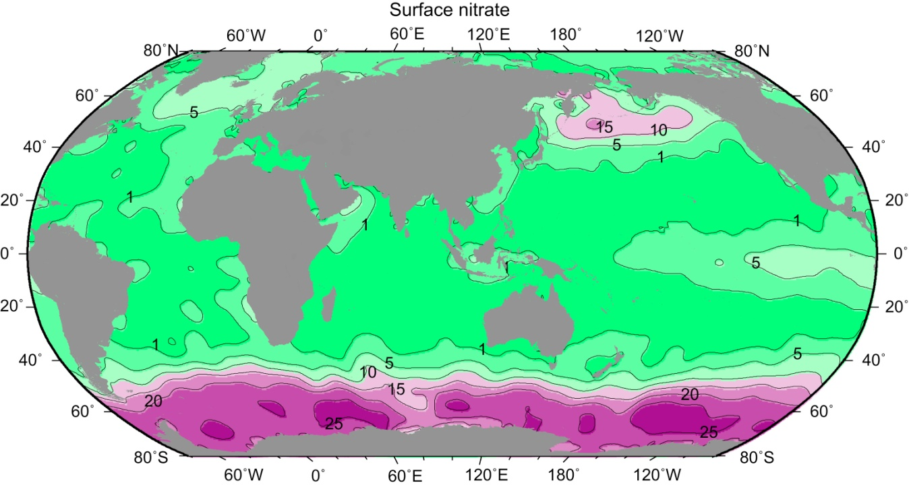
High surface nutrients due to upwelling of deep water
Nitrate (μmol/L) at the sea surface, from the climatological data set of Conkright, Levitus, and Boyer (1994).

Slide 15
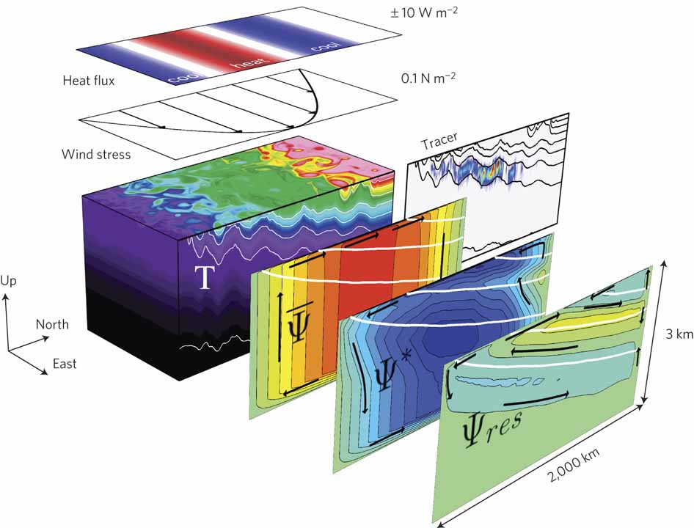
Dynamics: re-entrant channel flow
Marshall and Speer (Nat. Geos., 2012)
Based on Abernathey et al. (2011)

Slide 16
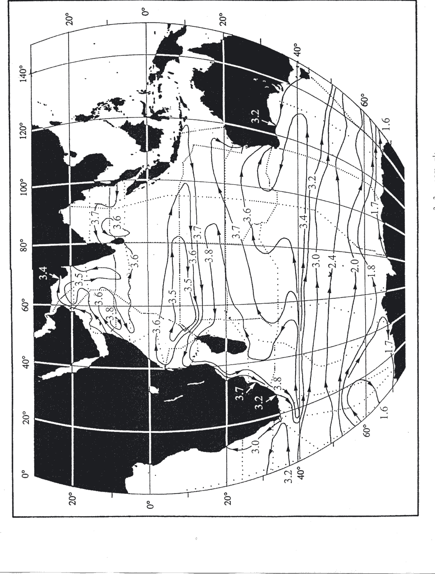
Southern Ocean surface circulation: ACC
Asymmetry of the ACC:
farthest north at Argentina
farthest south entering Drake Psg from Pacific
Malvinas (Falkland Current): semi-western boundary current for the ACC
(Similar effect of Campbell Plateau on ACC)
(Reid, 1994, 1997, 2003)

Slide 17
Antarctic Circumpolar Current
No meridional boundary at Drake Passage latitudes
Different dynamics from normal gyres (which have western and eastern boundaries)
Wind stress causes current that extends to bottom, flows eastward
Shear from 50 cm/sec at surface to about 5-10 cm/sec at bottom
Geopotential ht. anomaly 50/1000dbar
(Orsi et al., 1995) DPO Fig. 13.8
Notes:
Got to here

Slide 18
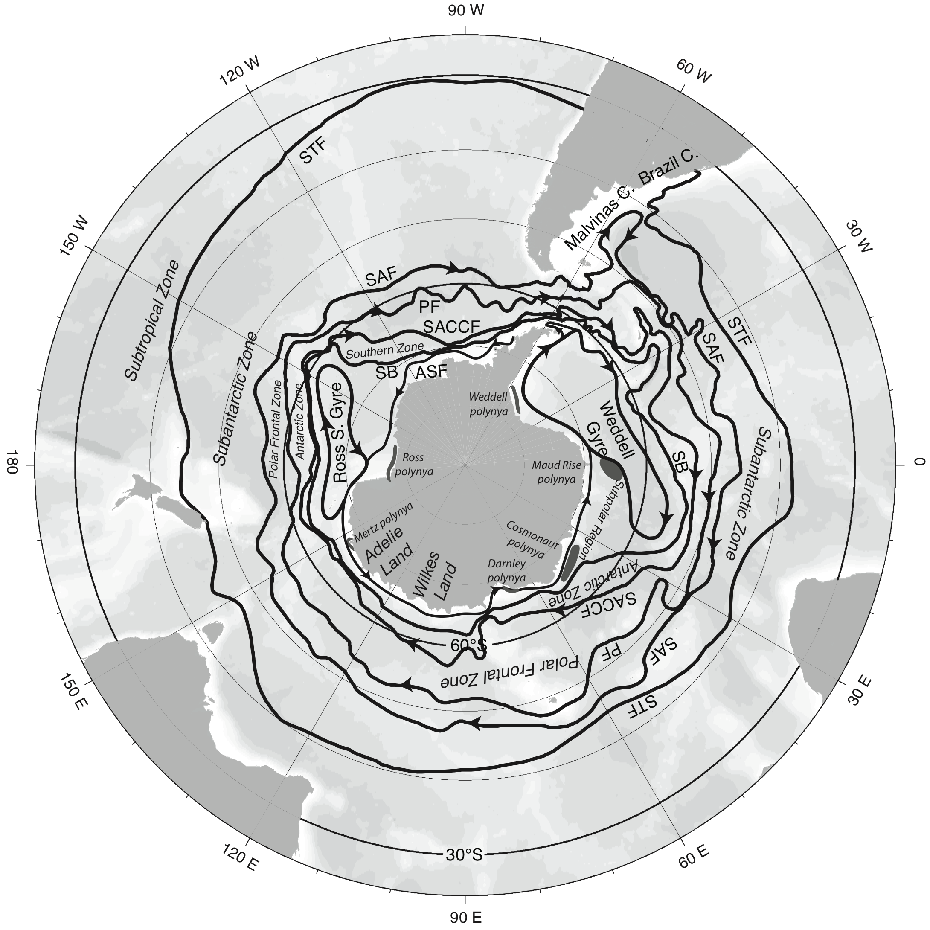
Antarctic Circumpolar Current: banded (jet-like) structure
Fronts of the Antarctic Circumpolar Current
Subantarctic Front on north side
Polar Front in middle
Southern ACC Front to south
Southern Boundary or continental shelf front
Antarctic Slope Front (westward flow along continental slope)
DPO Figure 13.1 (after Orsi et al., 1995)

Slide 19
Fronts of the Antarctic Circumpolar Current
Tomczak and Godfrey, Ch. 6
Most transport is carried in the fronts
Subantarctic Front and Polar Front most important
Another important front: Southern ACC Front (not shown here)

Slide 20
ACC speeds and transport in Drake Passage
Geostrophic calculations, current meters and ADCP measurements in Drake Passage suggest:
Maximum current speeds: ~50 cm/sec
Maximum currents in the 2 fronts (SAF and PF)
Transport of about 100 Sv, top to bottom, including all fronts (and intervening possible westward recirculations, eddies)
Transports elsewhere up to 150 Sv
SAF
PF
SACCF
DPO Fig. 13.19
(Lenn et al., 2007)

Slide 21
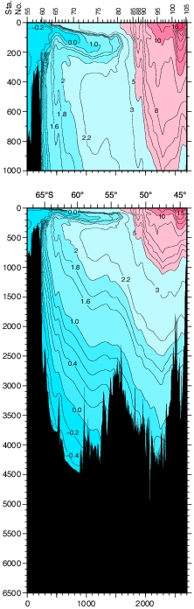
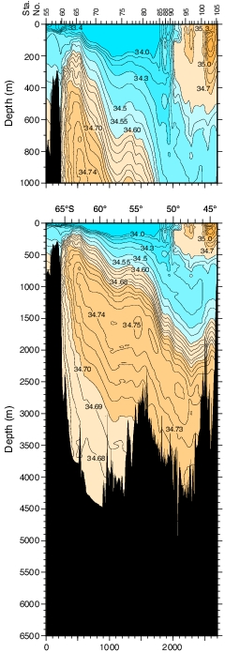
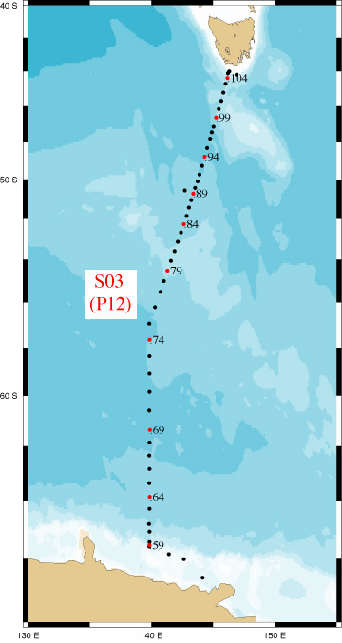
Polar and Subantarctic Fronts in temperature and salinity sections
Polar Front: onset of temperature minimum layer to south of PF
Subantarctic Front: onset of AAIW salinity minimum to north of SAF
Vertical section from Antarctica to Tasmania

Slide 22
Southern Ocean surface circulation: cyclonic subpolar (polar) gyres – Weddell Sea gyre
Track of the Endurance (Shackleton): cyclonic through the Weddell Sea ice pack (Royal Geographic Society)
Weddell Sea gyre
(Reid, 1994)
DPO Fig. 9.2a
DPO Fig. 13.10

Slide 23
Southern Ocean surface circulation: cyclonic subpolar (polar) gyres – Ross Sea gyre
Ross Sea gyre (Reid, 1997)
DPO Fig. 10.2a

Slide 24
Southern Ocean surface circulation Connection to anticyclonic subtropical gyres
Adjusted steric height
(Reid, 1994, 1997, 2003)

Slide 25
Southern Ocean deep circulation
2000 dbar
At 2000 dbar:
very similar direction as surface circulation
(ACC, Weddell and Ross Sea gyres)
“equivalent barotropic”: “barotropic” = same top to bottom; “equivalent” means there’s vertical shear but flow is in same direction at all depths
weaker currents
(Reid, 1994, 1997, 2003)
DPO Fig. 14.4a

Slide 26
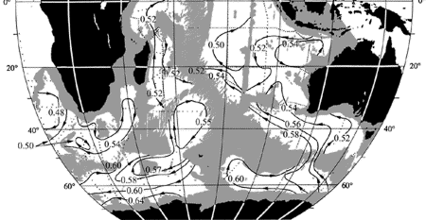
Southern Ocean abyssal circulation
At 4000 dbar:
Strong control by topography
Closed at Drake Passage
Weddell Gyre still apparent
Deep Western Boundary Currents carrying Circumpolar Deep Waters northward
4000 dbar
(Reid, 1994, 1997, 2003)
DPO Fig. 14.4b

Slide 27
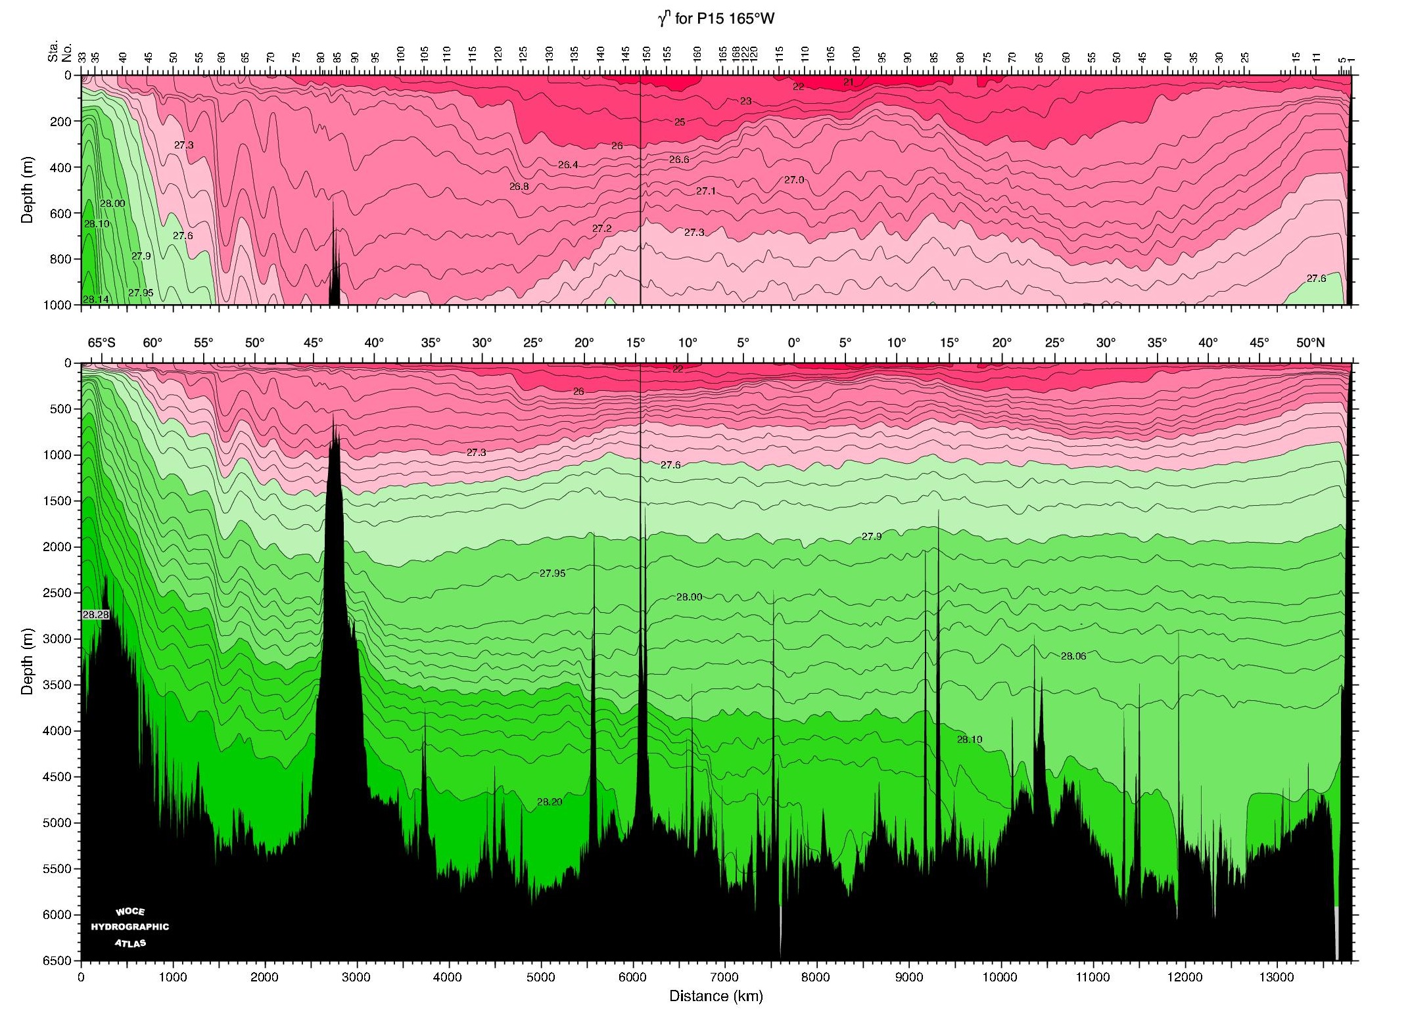
Geostrophic flow of ACC: (Pacific)
Antarctic Circumpolar Current
SACCF PF SAF (locations determined from theta and salinity)
Geostrophic (thermal wind) calculation: sloping isopycnals indicate eastward current (out of page) if strongest at surface
Shear reaches to bottom
> 1000 km wide band, but full of wiggles (fronts and eddies)
Neutral density section from http://www-pord.ucsd.edu/whp_atlas/pacific_index.html

Slide 28
Southern Ocean water properties and water masses
Major processes
Upwelling (from deep water to surface - can see in nutrients)
Buoyancy loss (cooling) and surprising GAIN (freshening)
Sea ice formation: brine rejection creating dense water
Notes:
heating

Slide 29
Southern Ocean buoyancy flux
Note the surprising net buoyancy gain through most of the Southern Ocean: contributions from both heat gain and net precipitation
DPO Fig. 13.2b

Slide 30
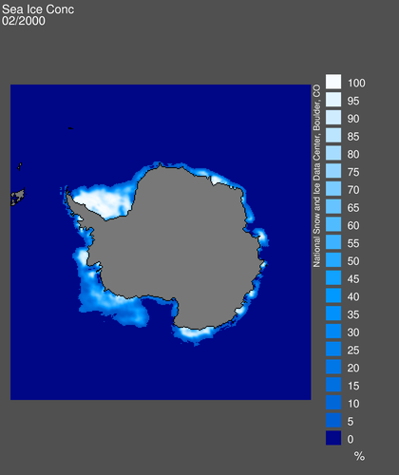
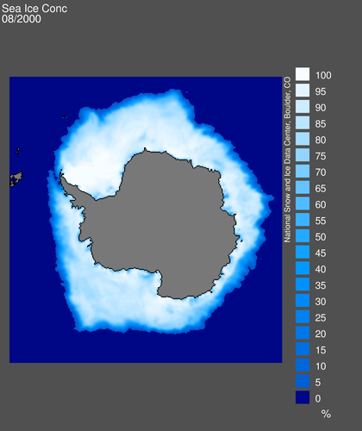
Antarctic ice distribution: sea ice concentration
After DPO Fig. 13.19
February and August, 2000 National Snow and Ice Data Center

Slide 31
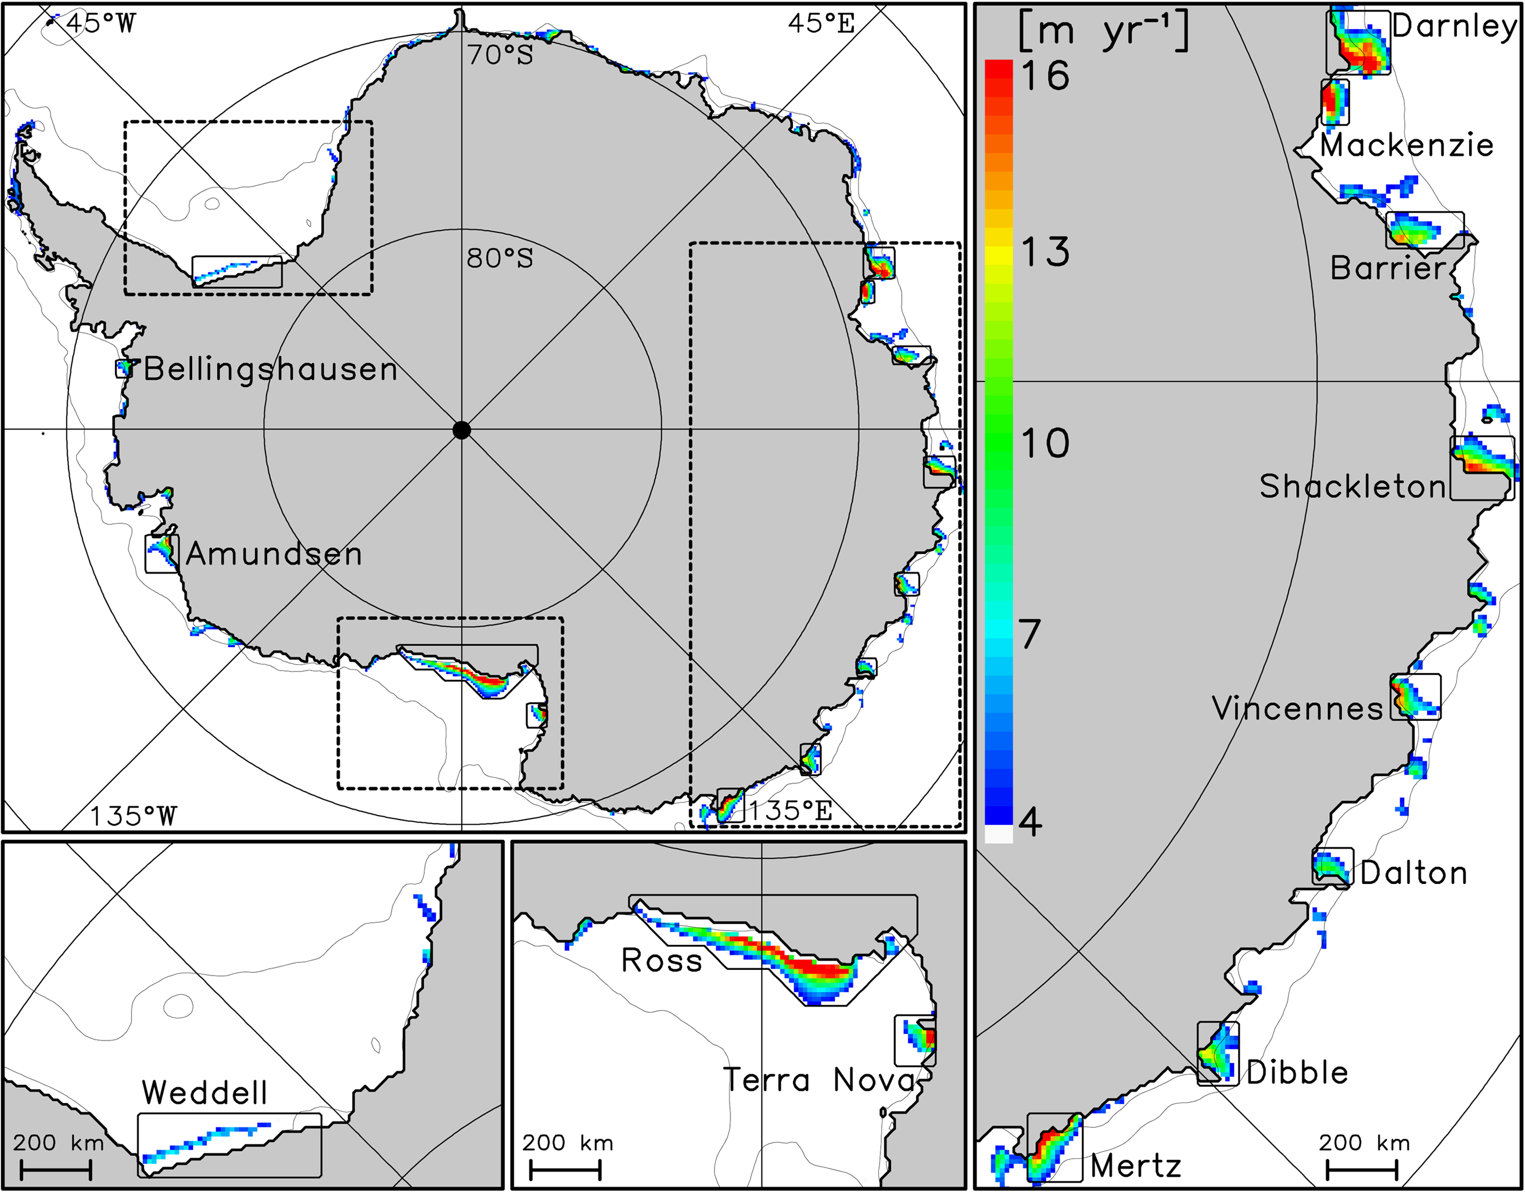
Antarctic polynyas: surface forcing
Coastal polynyas: regions characterized by high winds, open water, and large heat fluxes, hence major brine rejection sources.
Important sites for densest water:
Weddell, Ross, Mertz, (Darnley)
Tamura et al. (2008) (DPO Fig. 13.20)

Slide 32
Sea ice: dual role in water mass formation
Abernathey et al. (Nat GS 2016)
Freshwater input to the ocean:
Both from atmosphere and land (precip and runoff) AND
‘fractionation’ by sea ice:
Brine rejection where sea ice forms, makes ocean saltier (reds above)
Sea ice is pushed away by winds (Ekman) and melts farther north, which freshens the ocean (greens above)

Slide 33
Sea ice: dual role in water mass formation
Abernathey et al. (Nat GS 2016)
Brine rejection creates dense AABW
Sea ice melt lowers density of upwelled Deep Waters and inputs into thermocline water (Subantarctic Mode Water)

Slide 34
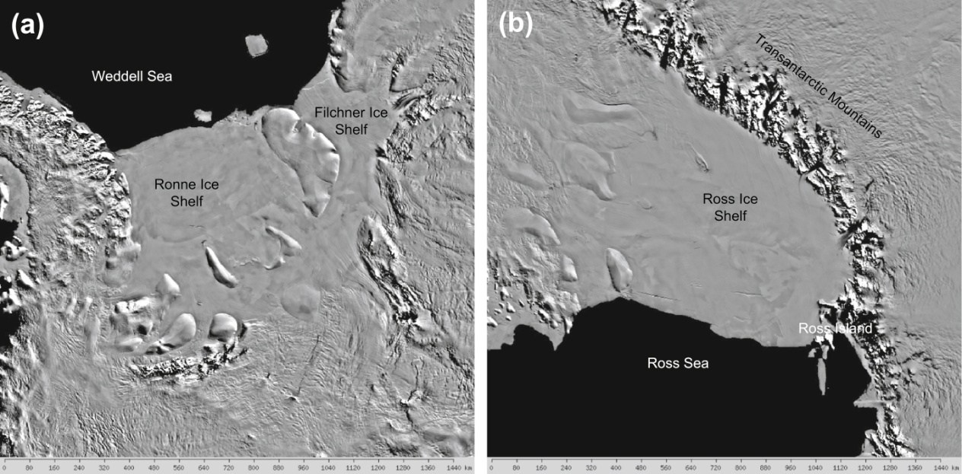
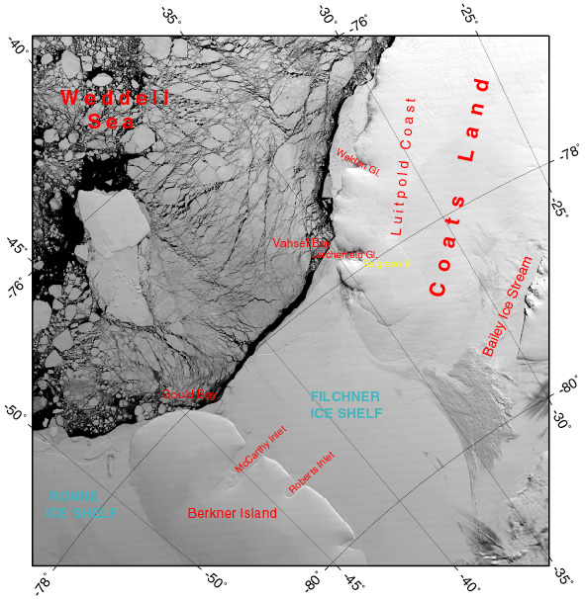
Antarctic ice shelves
Open areas (black) are polynyas and leads. Coastal polynyas especially can lead to large ice and brine production.
http://nsidc.org/data/iceshelves_images/

Slide 35
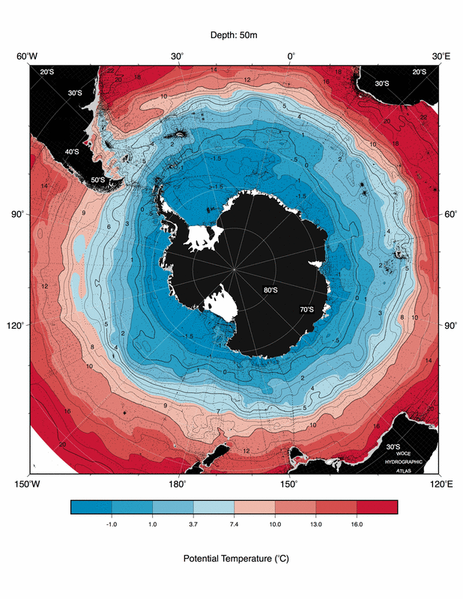
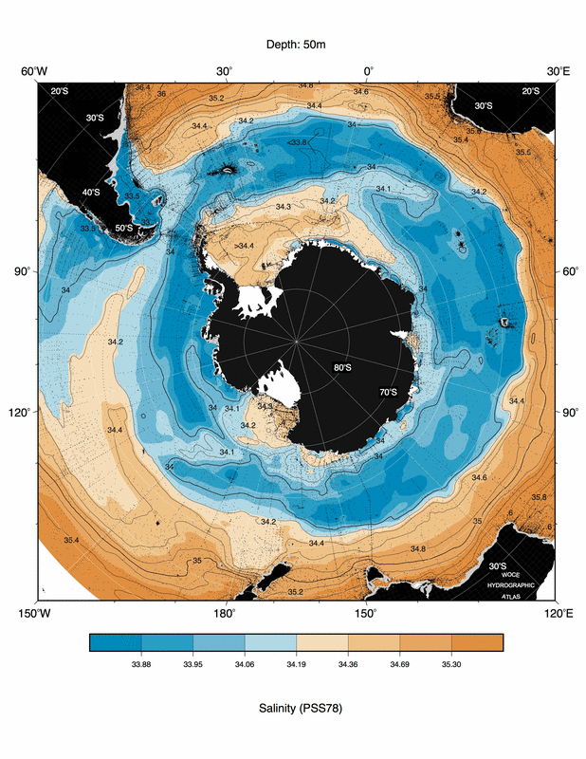
Southern Ocean near-surface properties
Freezing point around Antarctica. Higher salinity in Weddell, Ross.
Cold, saltier water -> dense water production due to brine rejection from sea ice formation
Orsi and Whitworth (2005) (DPO Fig. 13.3)

Slide 36
Southern Ocean water masses
Major water masses (covered on next slides)
Subantarctic Mode Water (thick surface layers north of SAF)
Antarctic Surface Water (cold, fresh surface layer south of PF)
Antarctic Intermediate Water (subsurface salinity minimum north of SAF)
Circumpolar Deep Water (Upper and Lower CDW):
Inflow of Atlantic, Pacific and Indian Deep Waters, formation of deep water in Weddell (brine rejection)
Antarctic Bottom Waters:
brine rejection in coastal polynyas and leads in ice

Slide 37
Water masses on section from Tasmania to Antarctica
ASW
SAMW
Antarctic Surface Water: very cold, fresh
Subantarctic Mode Water: thick layer north of SAF
UCDW
UCDW
AAIW
LCDW
AABW
AABW

Slide 38
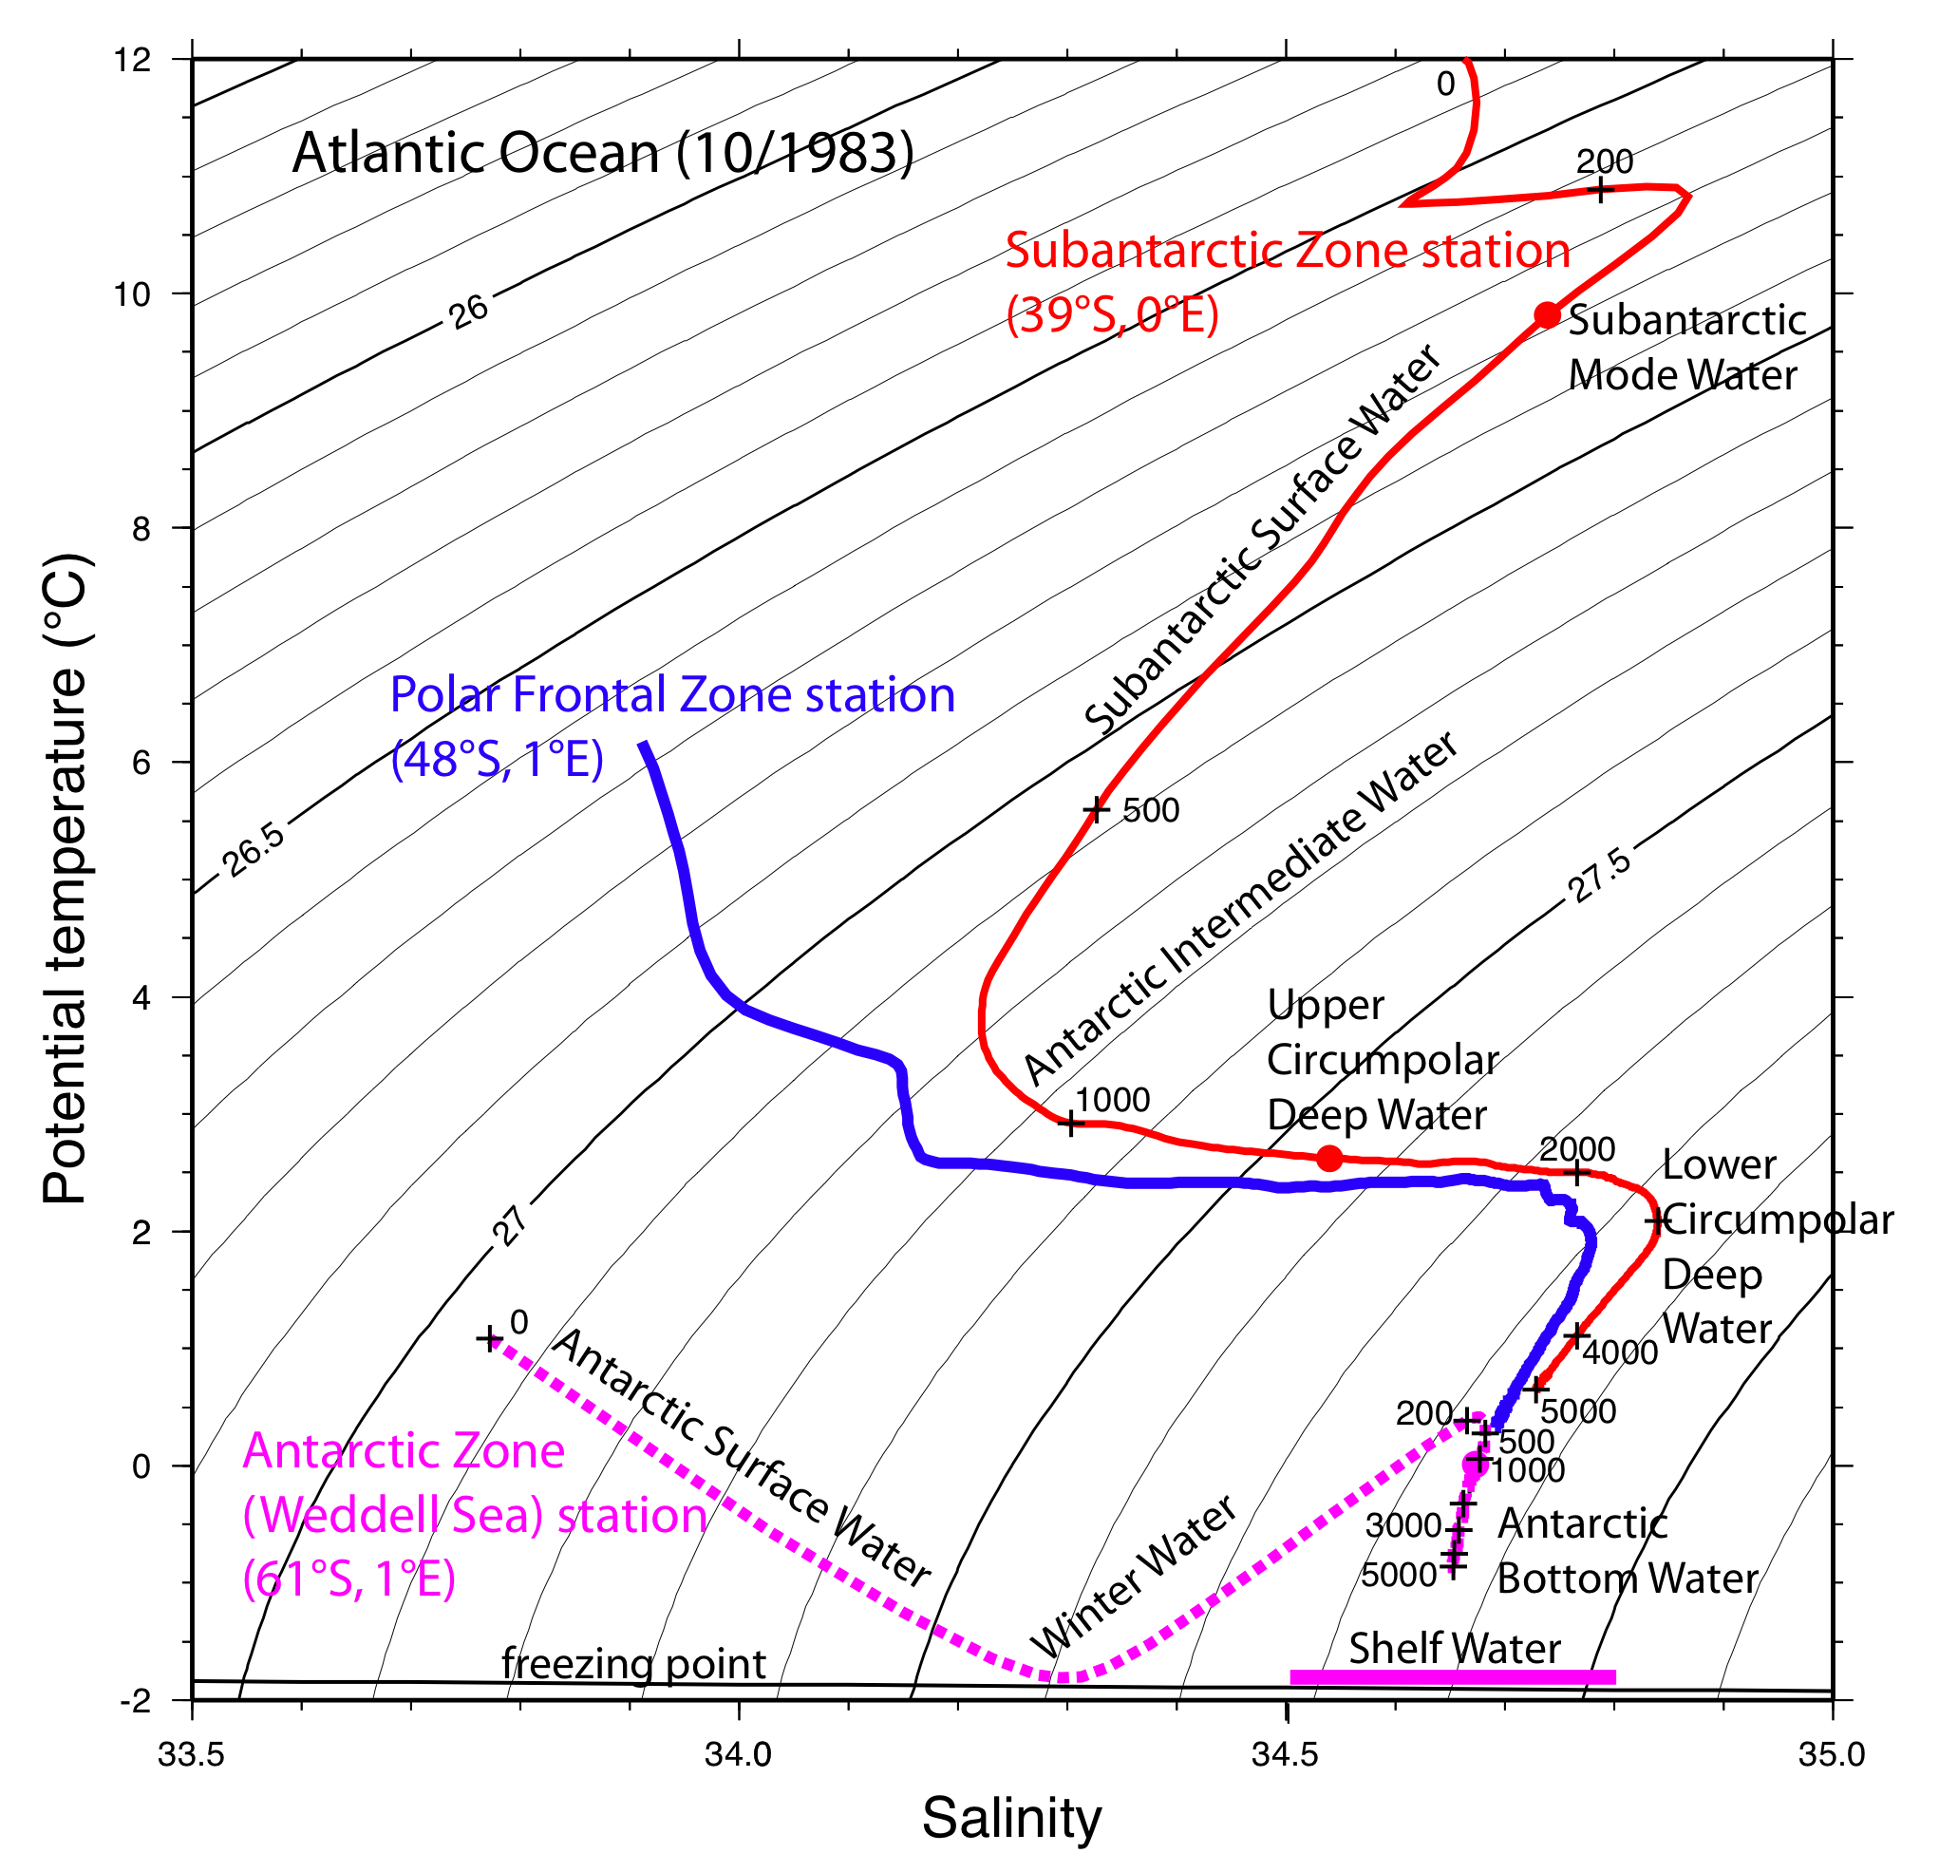
Potential temperature - salinity profiles in ACC
Tomczak and Godfrey Chap. 6
DPO Fig. 13.13

Slide 39
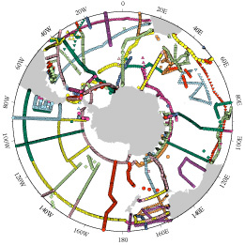
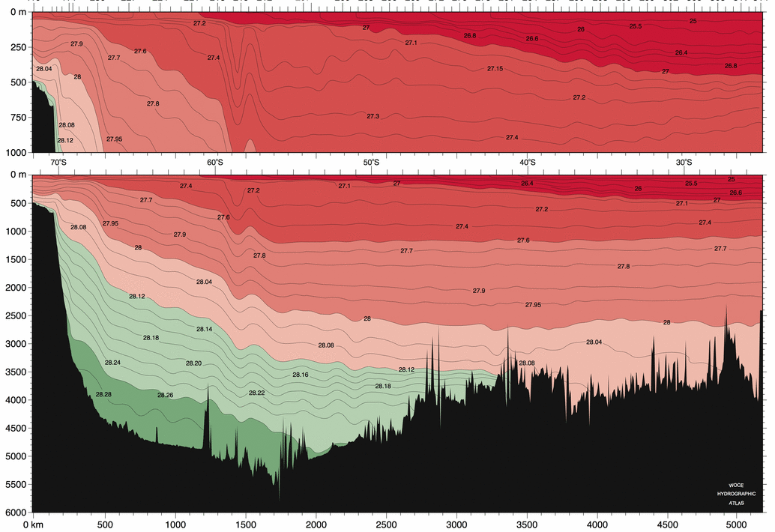
Subantarctic Mode Water: identification
SAMW: thick layer north of Subantarctic Front
http://woceatlas.tamu.edu

Slide 40
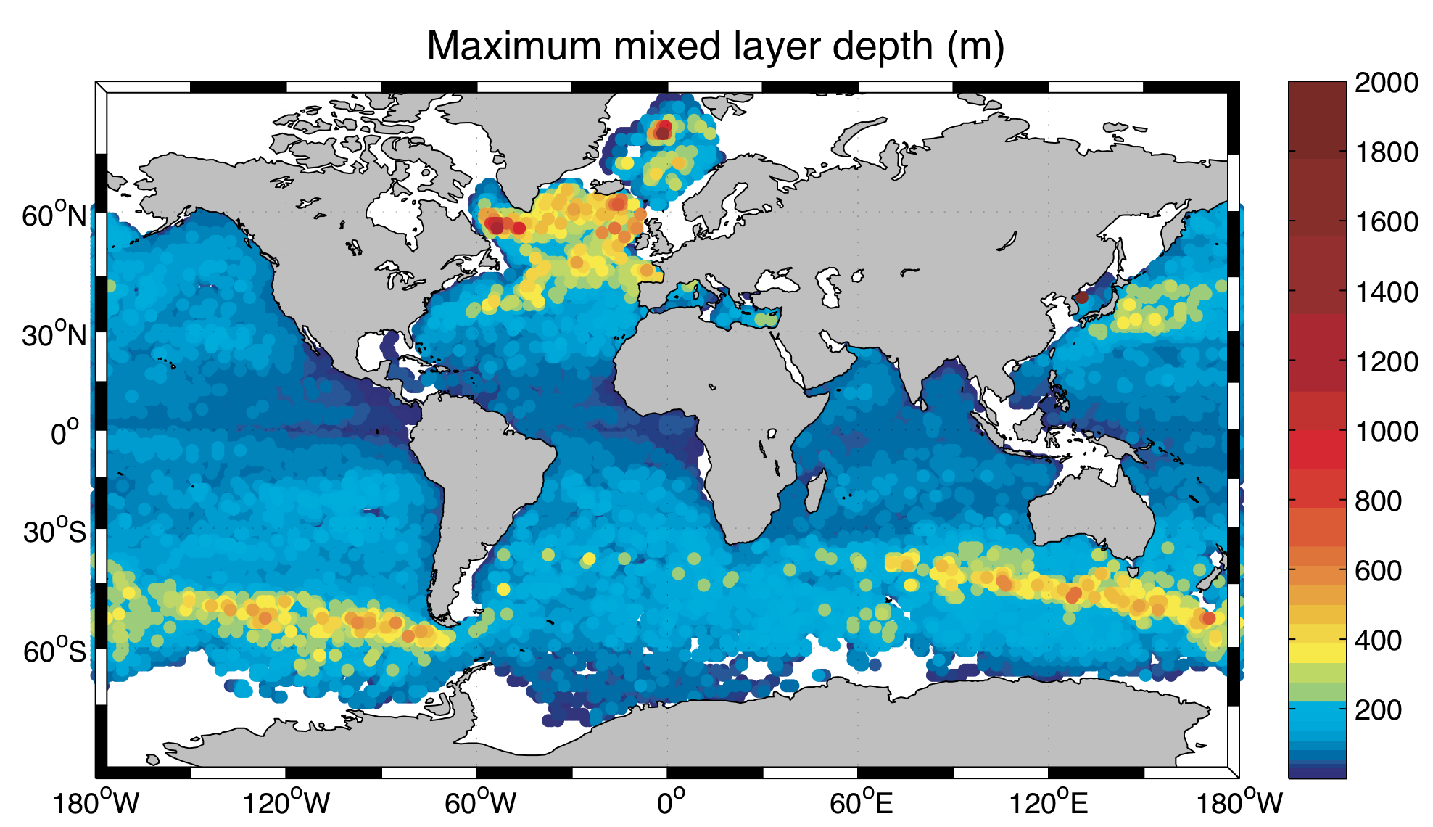
Subantarctic Mode Water: source in deep winter mixed layers north of SAF
14°C
9°C
4°C
Thick mixed layers in Southern Ocean: remnant subducts and becomes SAMW.
Just north of Subantarctic Front.
Progress from warmest (least dense) in S. Atlantic to coldest in SE Pacific
Holte et al (2010) DPO Fig. 4.4c

Slide 41
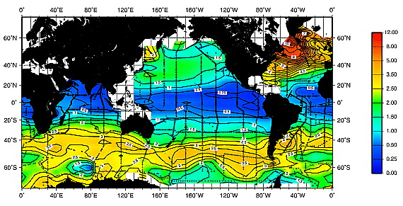
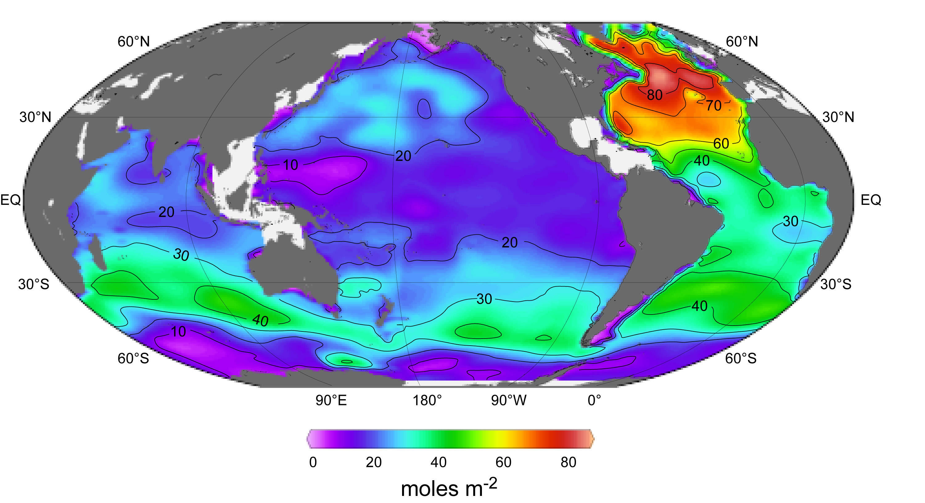
Subantarctic Mode Water: impact Chlorofluorocarbon and anthropogenic CO2 water column inventory
CFCs are anthropogenic tracers.
Indicate ventilation in the last ~50 years.
Anthropogenic CO₂
Coincidence of high inventories with location of SAMW
Willey et al. 2005
Sabine et al., 2005

Slide 42
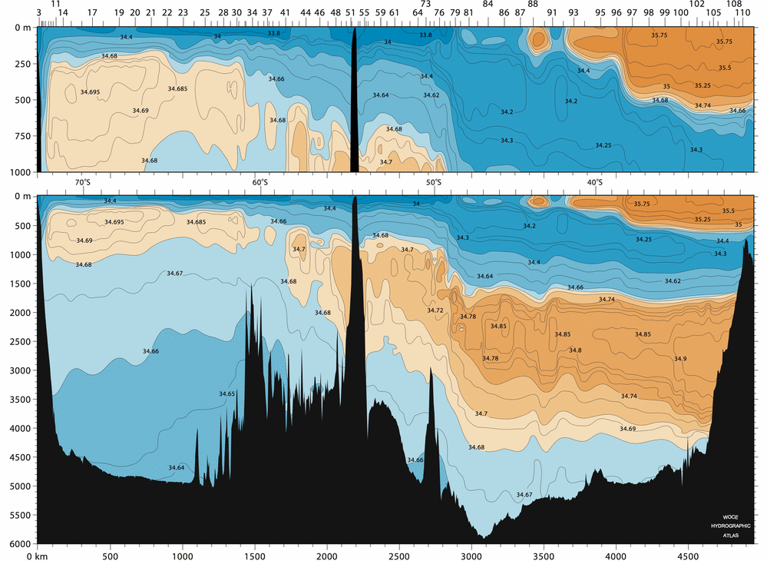
Salinity section at 20W (Atlantic): water masses
Antarctic Surface Water
ASW
Antarctic Intermediate Water (salinity minimum north of SAF)
Lower Circumpolar Deep Water (salinity maximum, arising from North Atlantic Deep Water)
LCDW
AAIW
LCDW
WSDW
NADW
Weddell Sea Deep Water and Antarctic Bottom Water (low salinity, cold bottom layer)
WSBW
AABW
http://woceatlas.tamu.edu

Slide 43
Salinity section at 20W (Atlantic): water masses
ASW
Antarctic Intermediate Water (salinity minimum north of SAF in all oceans)
LCDW
AAIW
LCDW
WSDW
NADW
WSBW
AABW
http://woceatlas.tamu.edu

Slide 44
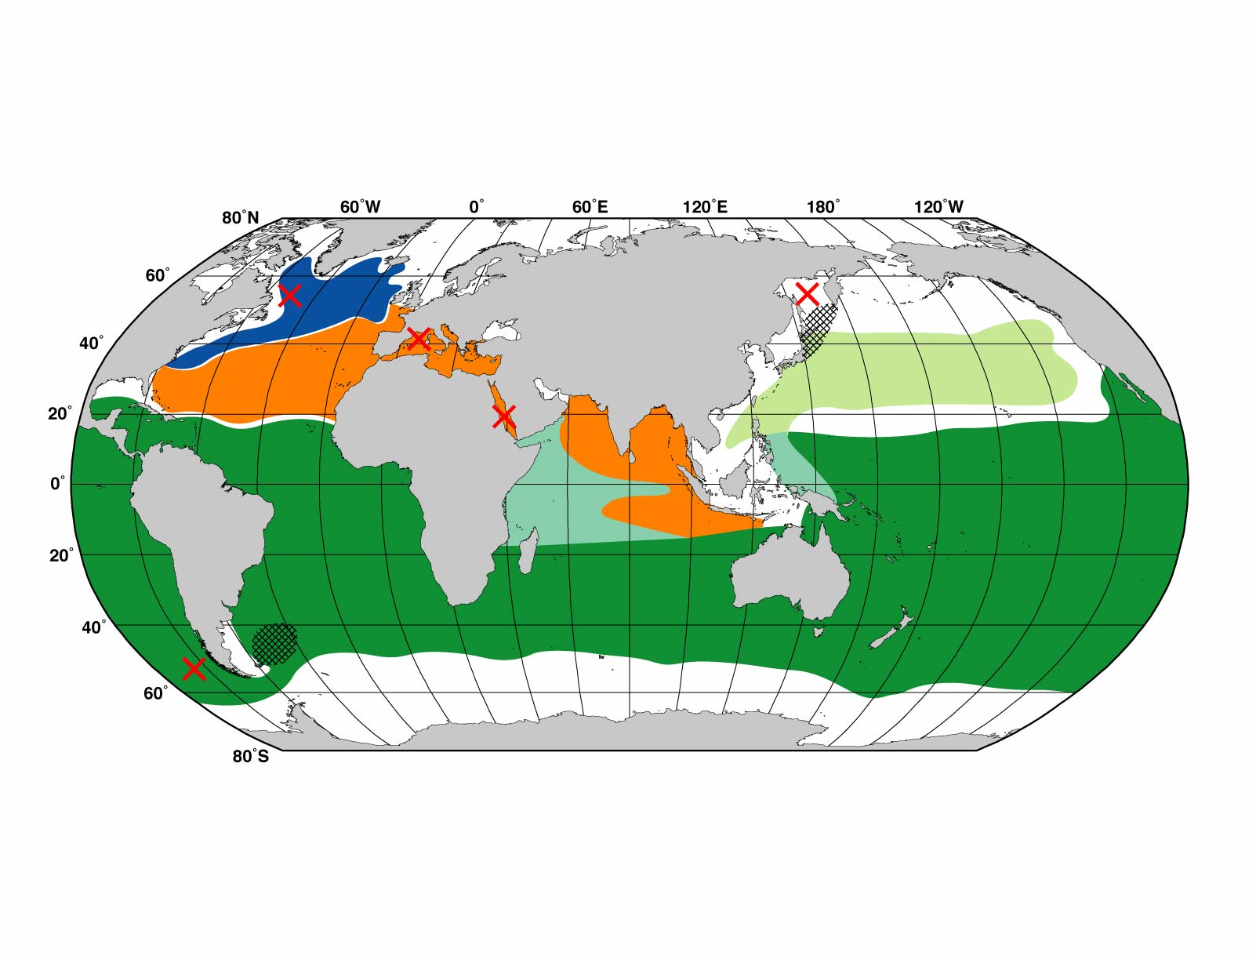
Antarctic Intermediate Water: source as densest, freshest SAMW?
Intermediate water production sites
Dark green: AAIW salinity minimum location
Formation site: west, in, east of Drake Passage

Slide 45
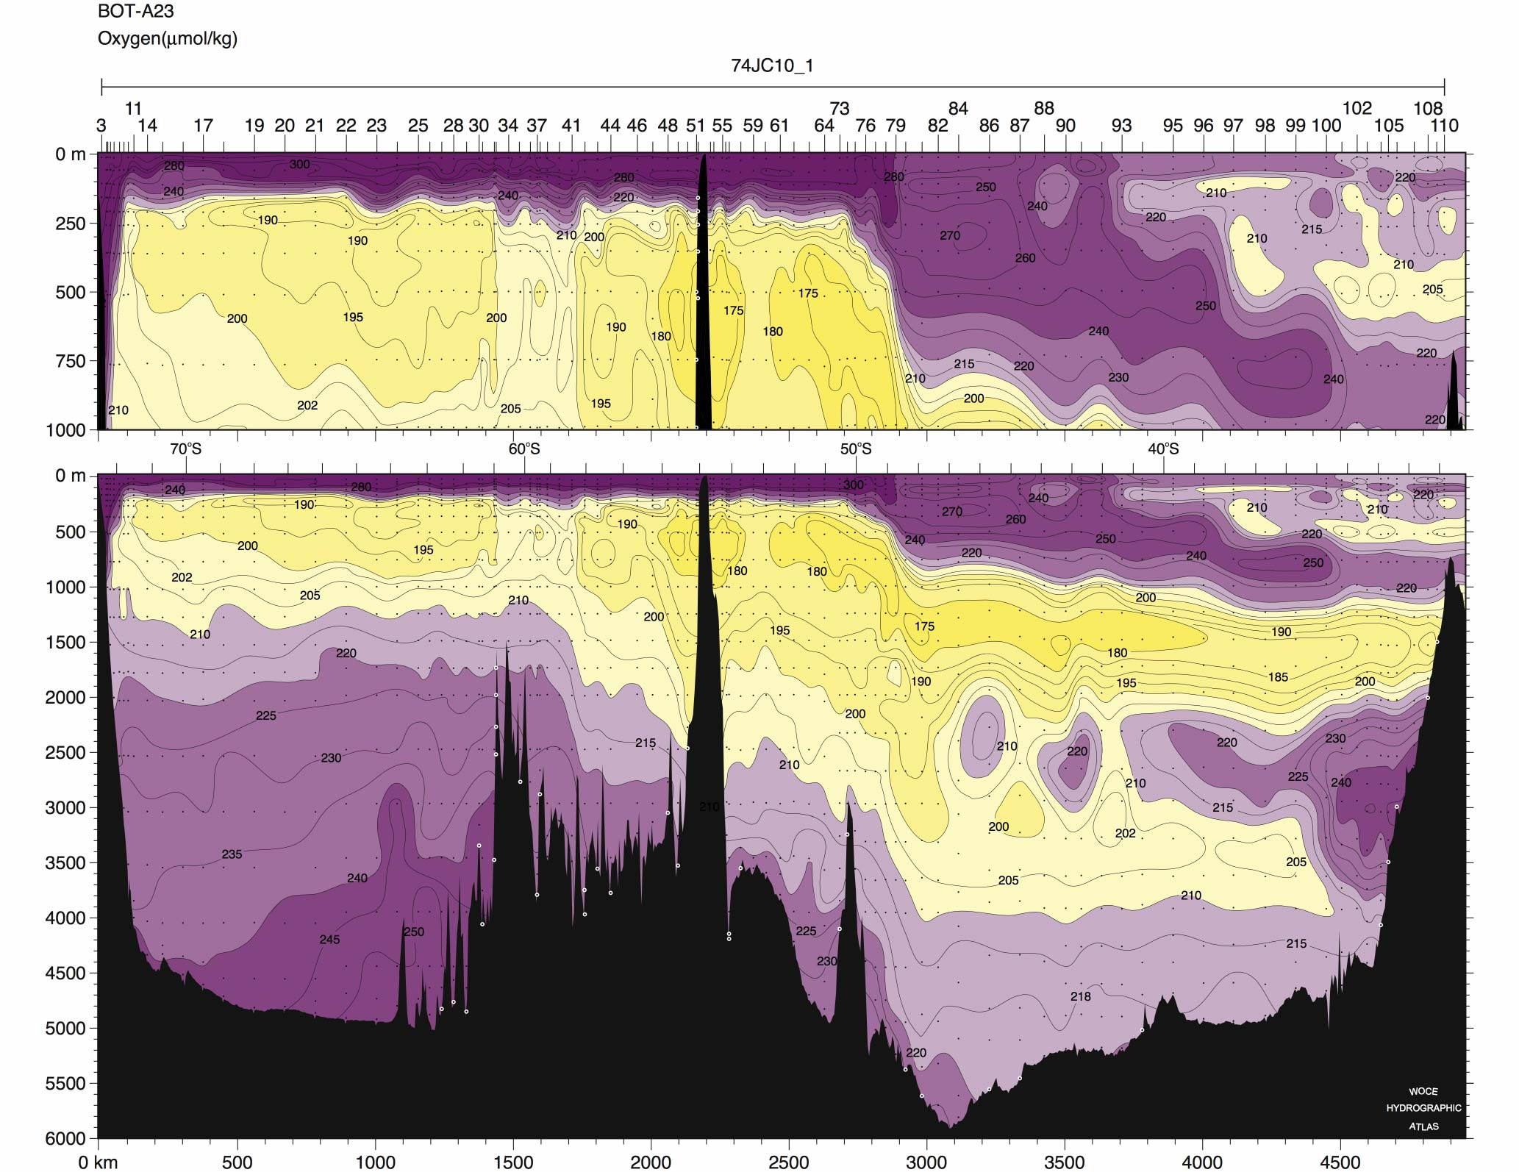
Southern Ocean water masses: Oxygen section at 20W (Atlantic)
ASW
UCDW
Upper Circumpolar Deep Water (oxygen minimum, arising from Pacific and Indian Deep Water)
(also the temperature maximum layer south of Polar Front)
LCDW
UCDW
SAMW
AAIW
LCDW
UCDW
WSDW
NADW
WSBW
AABW
http://woceatlas.tamu.edu

Slide 46
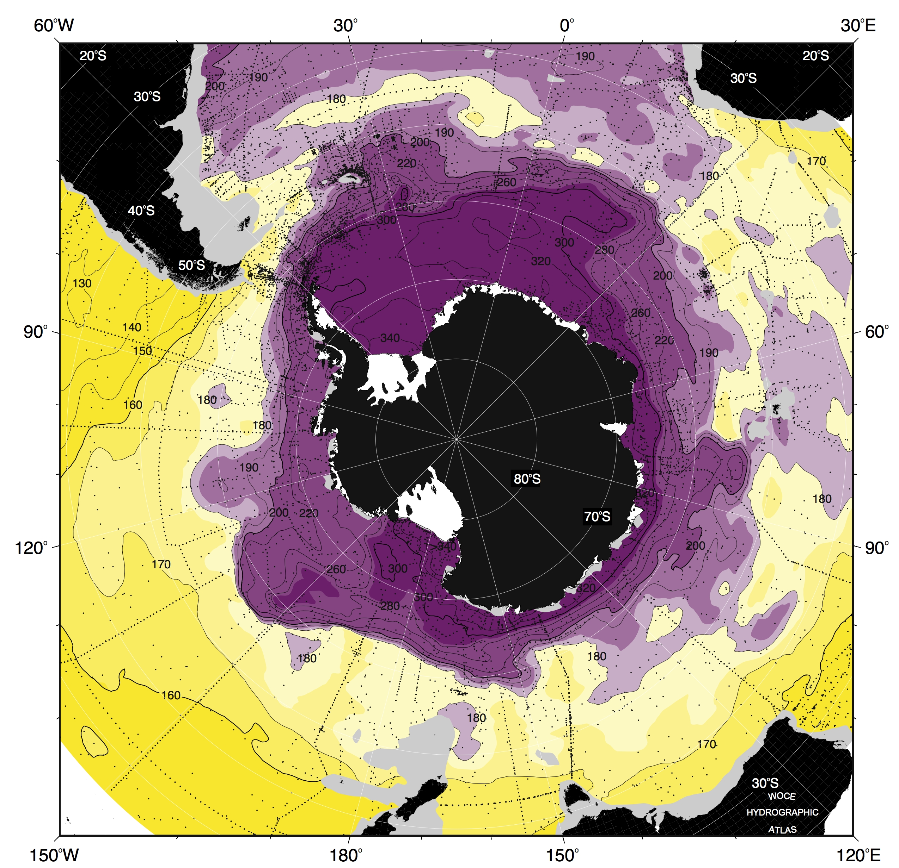
Upper Circumpolar Deep Water:low oxygen from PDW and IDW
Oxygen at
neutral density 27.84
Low oxygen from IDW, PDW
Highest oxygen from S.O. ventilation
http://woceatlas.tamu.edu

Slide 47
Lower Circumpolar Deep Water
ASW
Lower Circumpolar Deep Water (salinity maximum, arising from North Atlantic Deep Water)
LCDW
AAIW
LCDW
WSDW
NADW
WSBW
AABW
http://woceatlas.tamu.edu

Slide 48
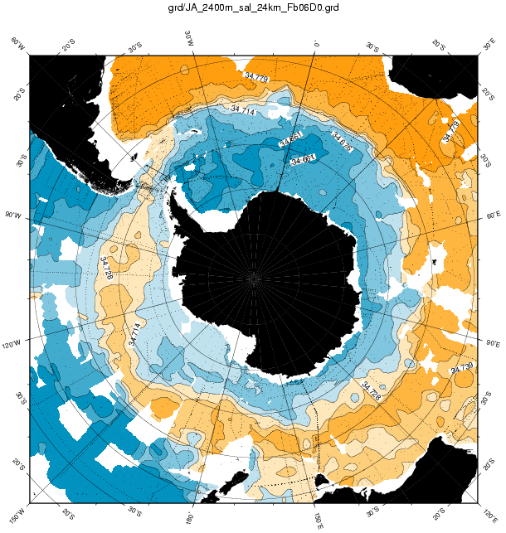
Lower Circumpolar Deep Water: high salinity comes from NADW
Salinity at
2400 meters
High salinity input from NADW
Fresh input from IDW, PDW, diluting the high salinity
http://woceatlas.tamu.edu

Slide 49
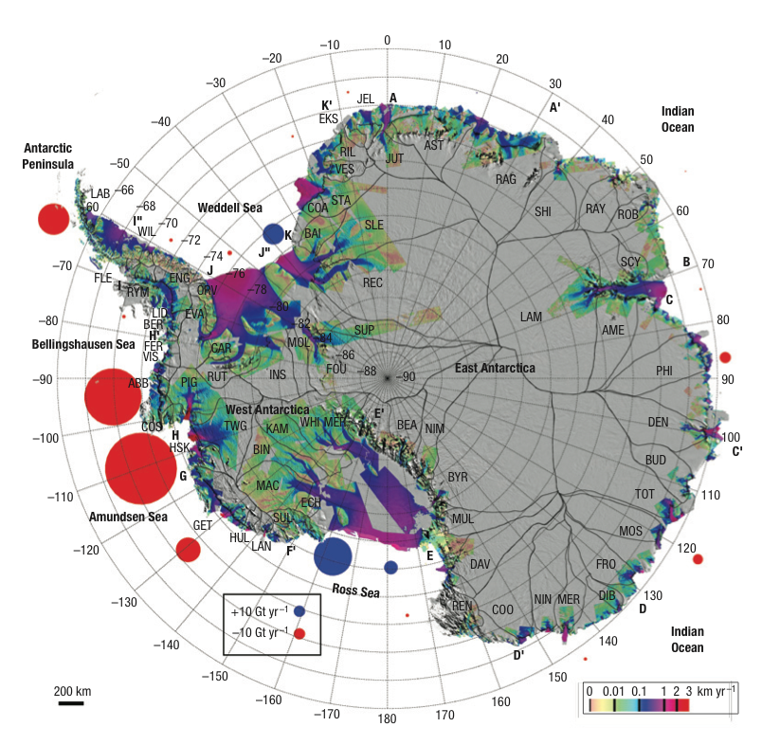
LCDW warm water upwells and comes close to Antarctic ice shelves
Ice sheet mass balances
→ sea level (Rignot et al.,2008)
Orsi and Whitworth (2005)
Rignot et al. (2008)
Notes:
What does heat do in the ocean?
Sea level rise
Keeping surface warm which keep atmosphere warm
Delivers heat to ice shelves which accelerates their melting, and hence changing sea level by potentially massive amounts.

Slide 50
Antarctic Bottom Water
ASW
LCDW
AAIW
LCDW
WSDW
NADW
Weddell Sea Deep Water
Antarctic Bottom Water (low salinity, cold bottom layer)
WSBW
AABW
http://woceatlas.tamu.edu

Slide 51
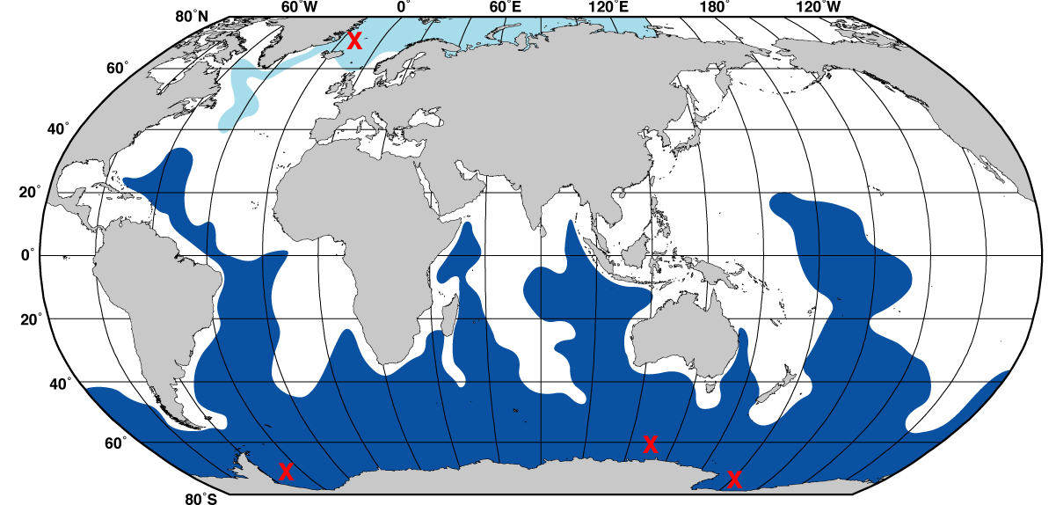
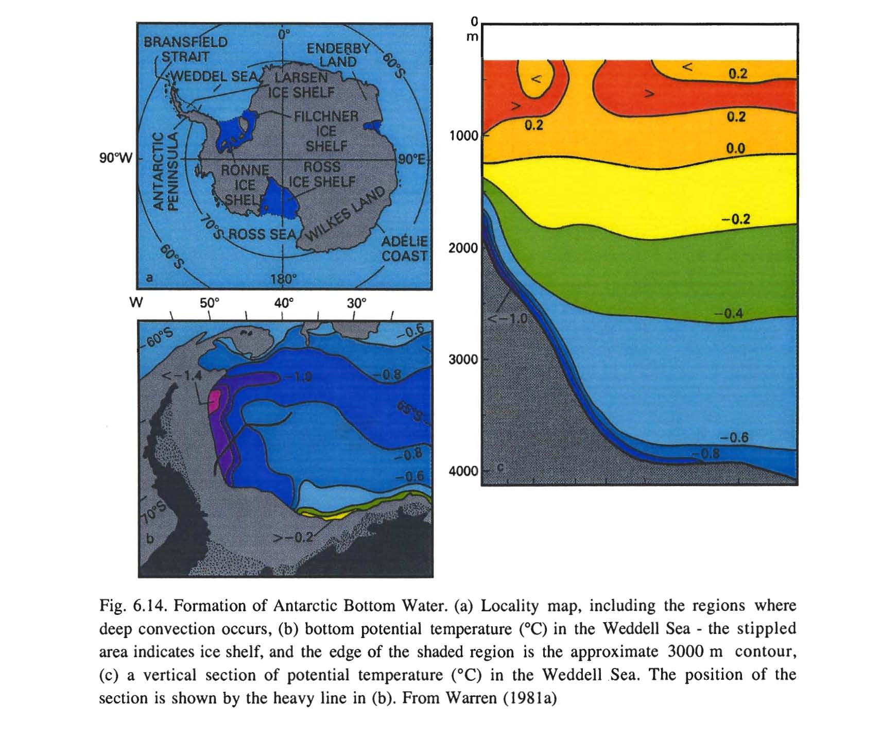
Antarctic Bottom Water
Deep and bottom water production sites: brine rejection in polynyas

Slide 52
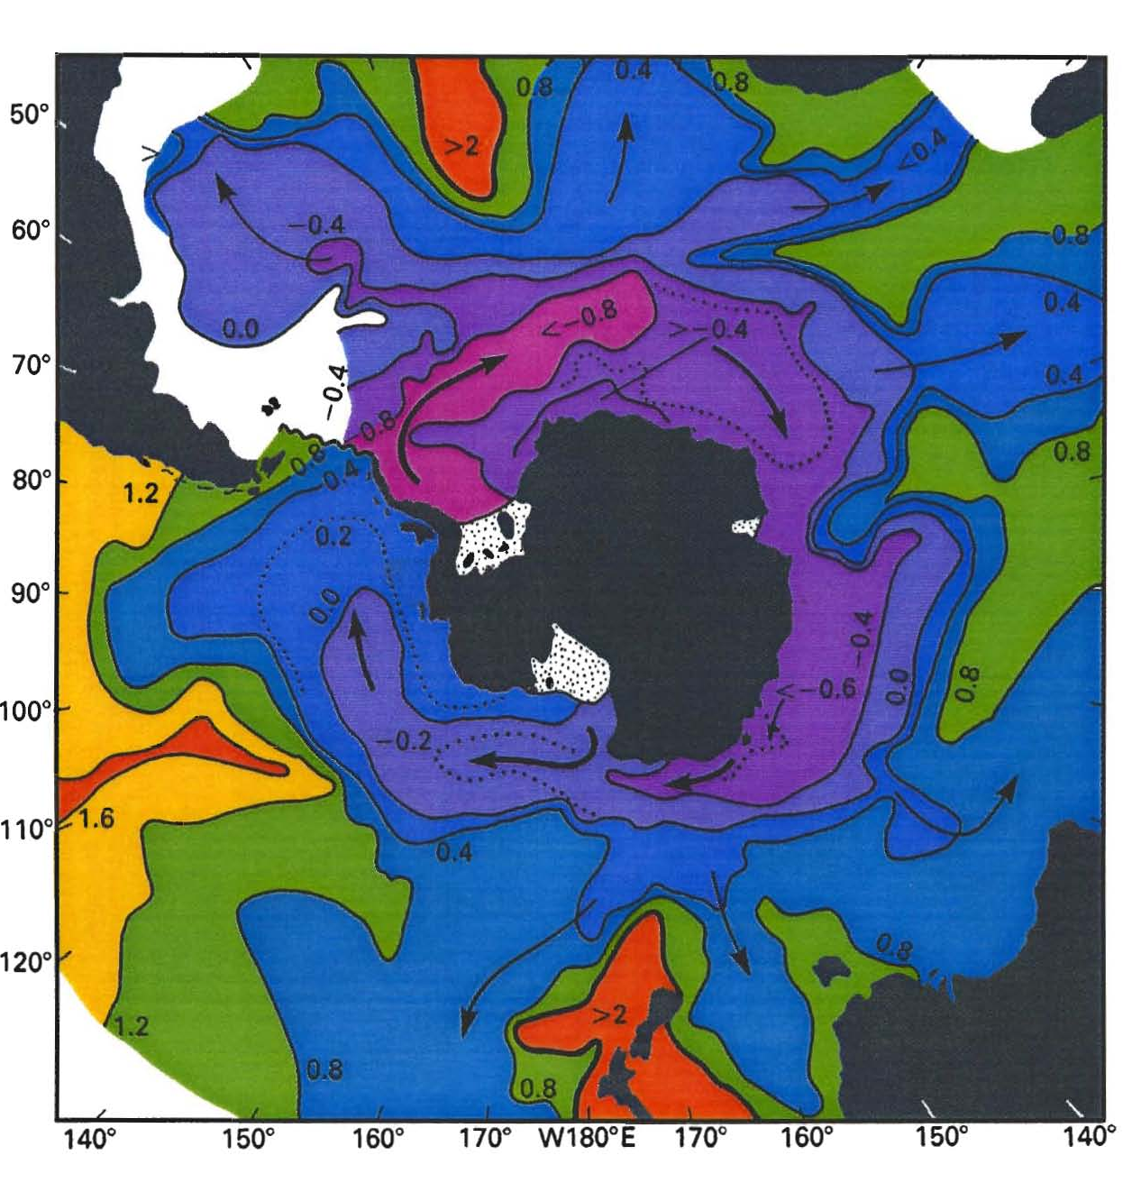
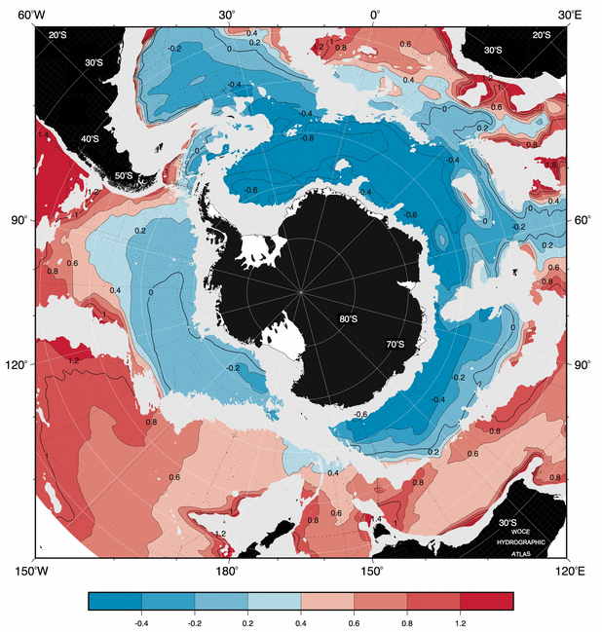
Antarctic Bottom Water
Bottom potential temperature
Bottom potential temperature, showing pathways of densest shelf waters around and away from Antarctica (Tomczak&Godfrey)
http://woceatlas.tamu.edu

Slide 53
AABW contribution to bottom water
Johnson (2008) DPO Fig. 14.15

Slide 54
Southern Ocean: meridional view of water masses and overturn
DPO Fig. 13.4 (after Speer et al. 2000)

