Slide 1
External forcing from the atmosphere L. Talley, SIO 210 CSP Fall, 2016
Heating and cooling
Evaporation/precipitation and runoff
Wind stress
Reading:
Review DPO Ch. 5.3, 5.4
DPO Chapter 5.7 (buoyancy flux), 5.8 (wind patterns)
Notes:
LOOK at new ideas of monsoon – Bill Boos, Simone at CalTech?

Slide 2
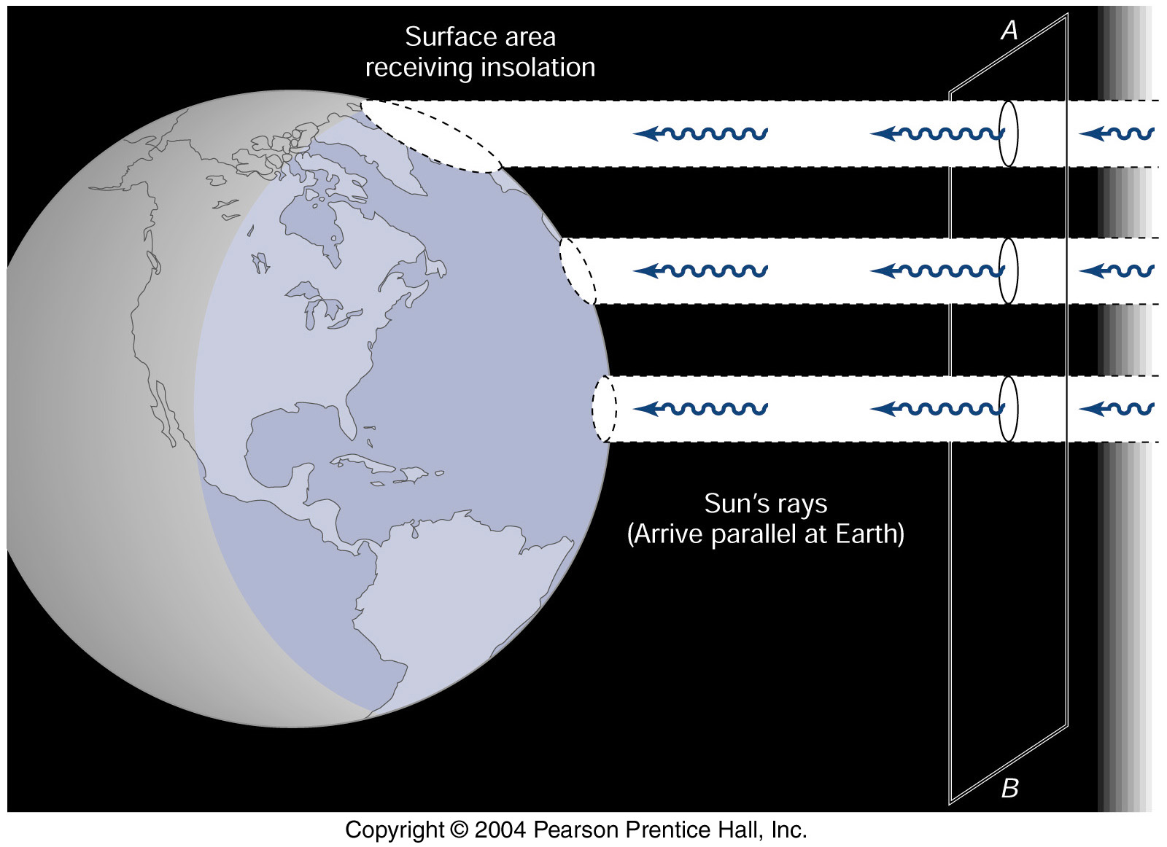
Global scale forcing: Solar radiation
More radiation reaches tropics than high latitudes, hence more heating in tropics than in high latitudes
Kump, Kasting, Crane (2004) textbook

Slide 3
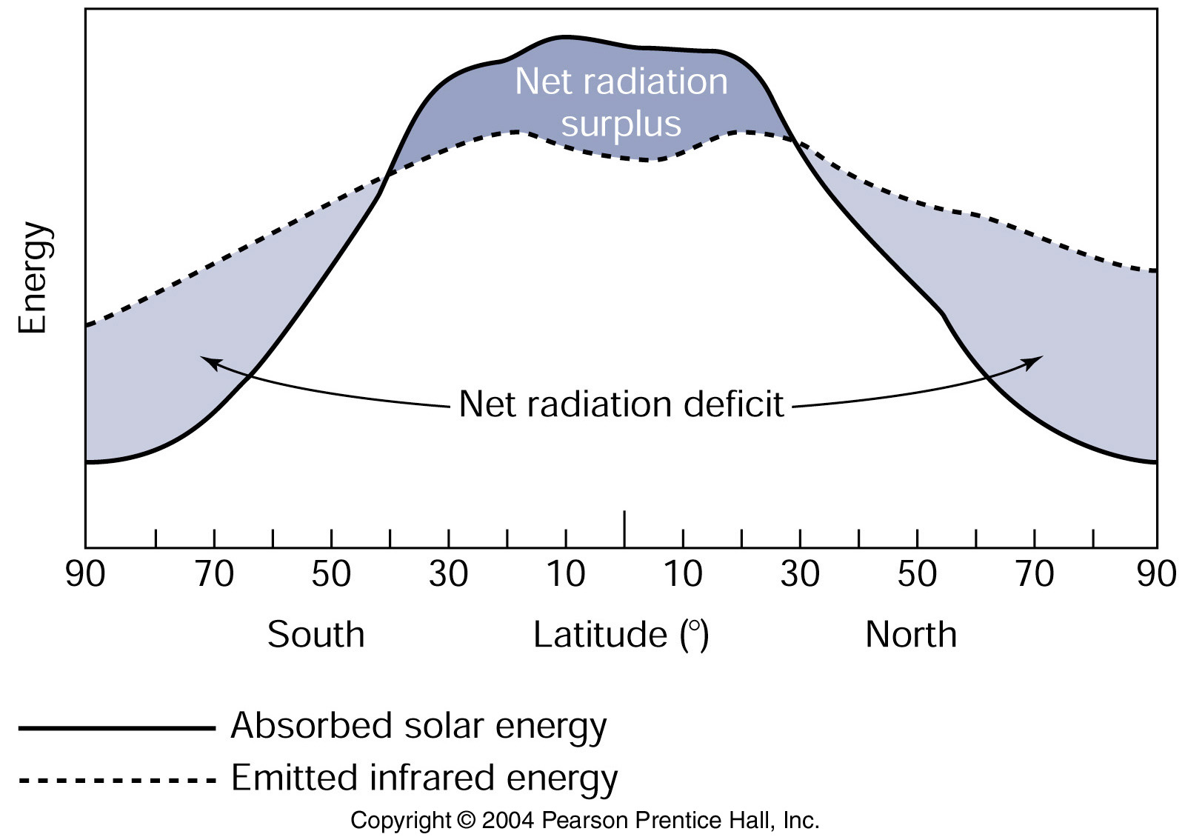
Global radiation balance - reasonable climate at mid to high latitudes because of winds (and ocean currents) that move heat
Kump, Kasting, Crane (2004) textbook

Slide 4
Net Surface heat flux (W/m²) into ocean
DPO Figure 5.12
Notes:
For steady state, heat must be transported out of the tropics to the cooling mid-latitudes (cooling)
Red line: example, heat transport should be northward across this line.

Slide 5
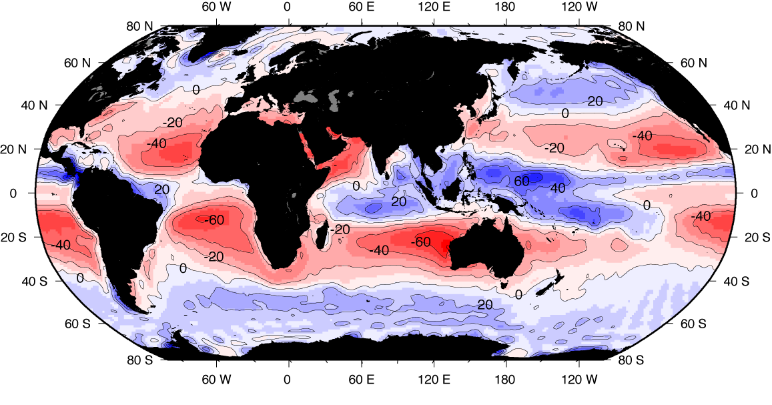
Precipitation minus evaporation (runoff from land is not depicted)
NCEP climatology
Notes:
Could use some kind of map showing runoff

Slide 6
Buoyancy flux
Density is changed by buoyancy flux, which is the sum of heat and freshwater flux (changing temperature and salinity)
Map is mostly related to heat flux, impact from E-P at high latitudes
DPO Figure 5.15

Slide 7
Surface wind stress (northern summer)
Average wind speeds up to 10 m/sec (factor of 10 greater than ocean current speeds)
Note westerlies and trades
Monsoonal winds in Indian Ocean
Look for monsoons in other tropical locations
DPO Fig. 5.16a

Slide 8
Atmospheric circulation L. Talley, SIO 210 CSP Fall, 2016
Vertical structure: troposphere, stratosphere, mesosphere, thermosphere
Forcing: unequal distribution of solar radiation
Direct circulation
Land and sea breeze
Monsoon
Equatorial: Walker circulation
Mean large-scale wind and pressure structure
Hadley circulation
Jet Stream
Surface pressure
Surface wind stress
Reading: Stewart Chapter 4
Other: DPO Chapter 5.8 (for wind patterns)
Notes:
LOOK at new ideas of monsoon – Bill Boos, Simone at CalTech?

Slide 9
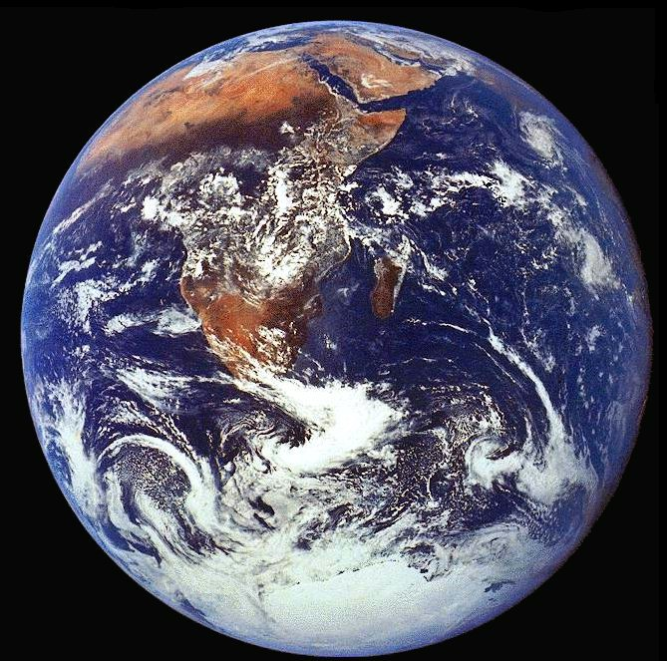

Slide 10
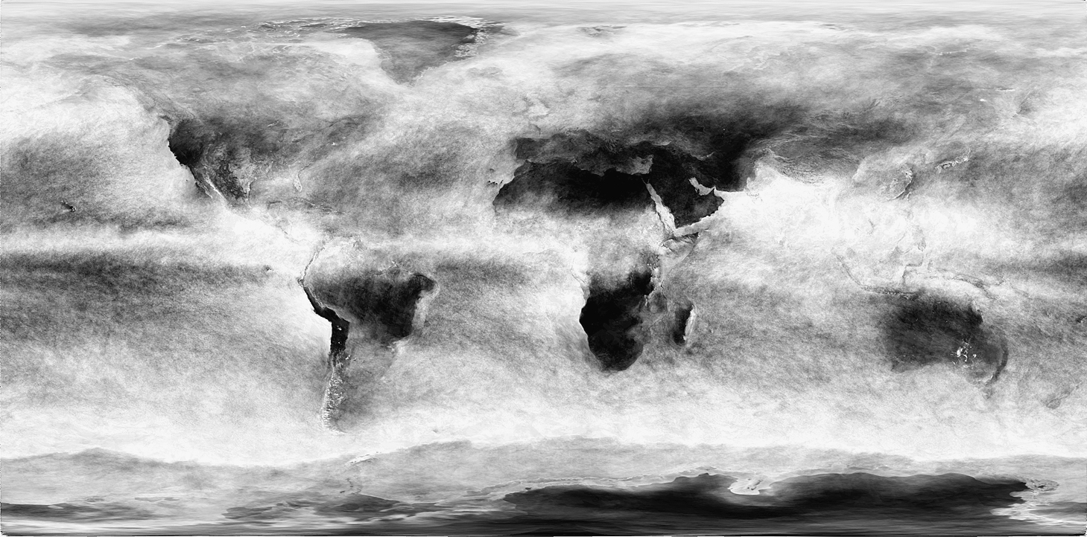
Cloud cover
associated with sea level pressure
(low pressure = rising air - moist;
high pressure = sinking air – dry)
Cloud fraction (monthly average for August, 2010) from MODIS on NASA’s Terra satellite. Gray scale ranges from black (no clouds) to white (totally cloudy). Source: From NASA Earth Observatory (2010).
TALLEY Copyright © 2011 Elsevier Inc. All rights reserved
DPO Figure 5.8

Slide 11
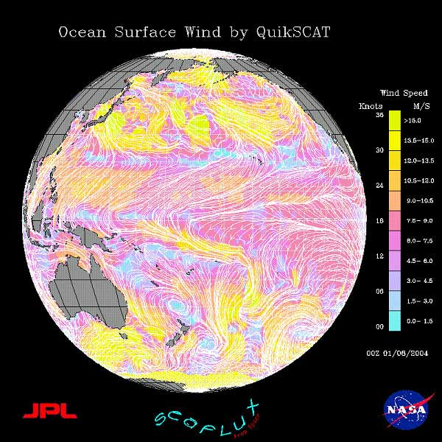
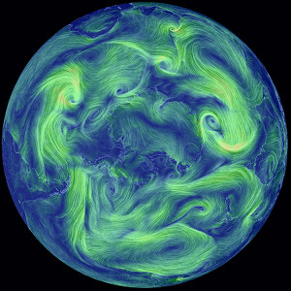
NASA and computer wind products
https://earth.nullschool.net/about.html
https://winds.jpl.nasa.gov/

Slide 12
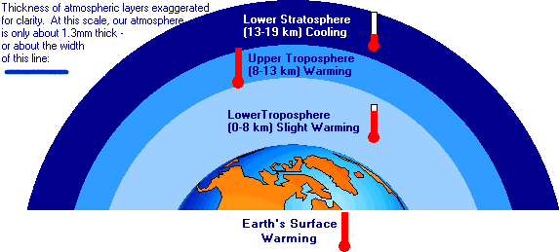
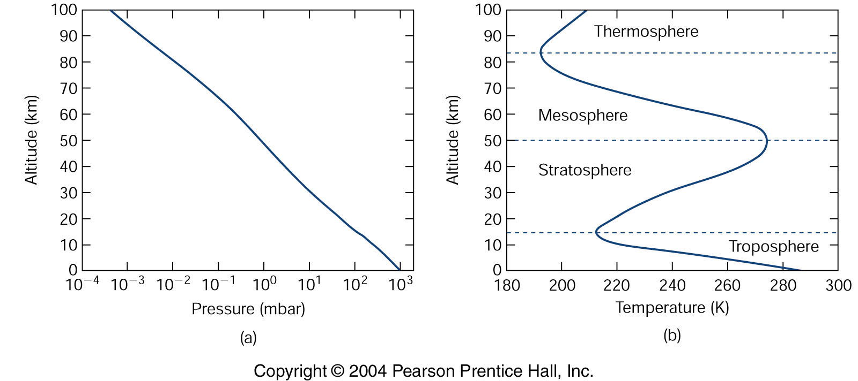
Atmosphere structure
From NASA Science site
Kump, Kasting, Crane (2004) textbook

Slide 13
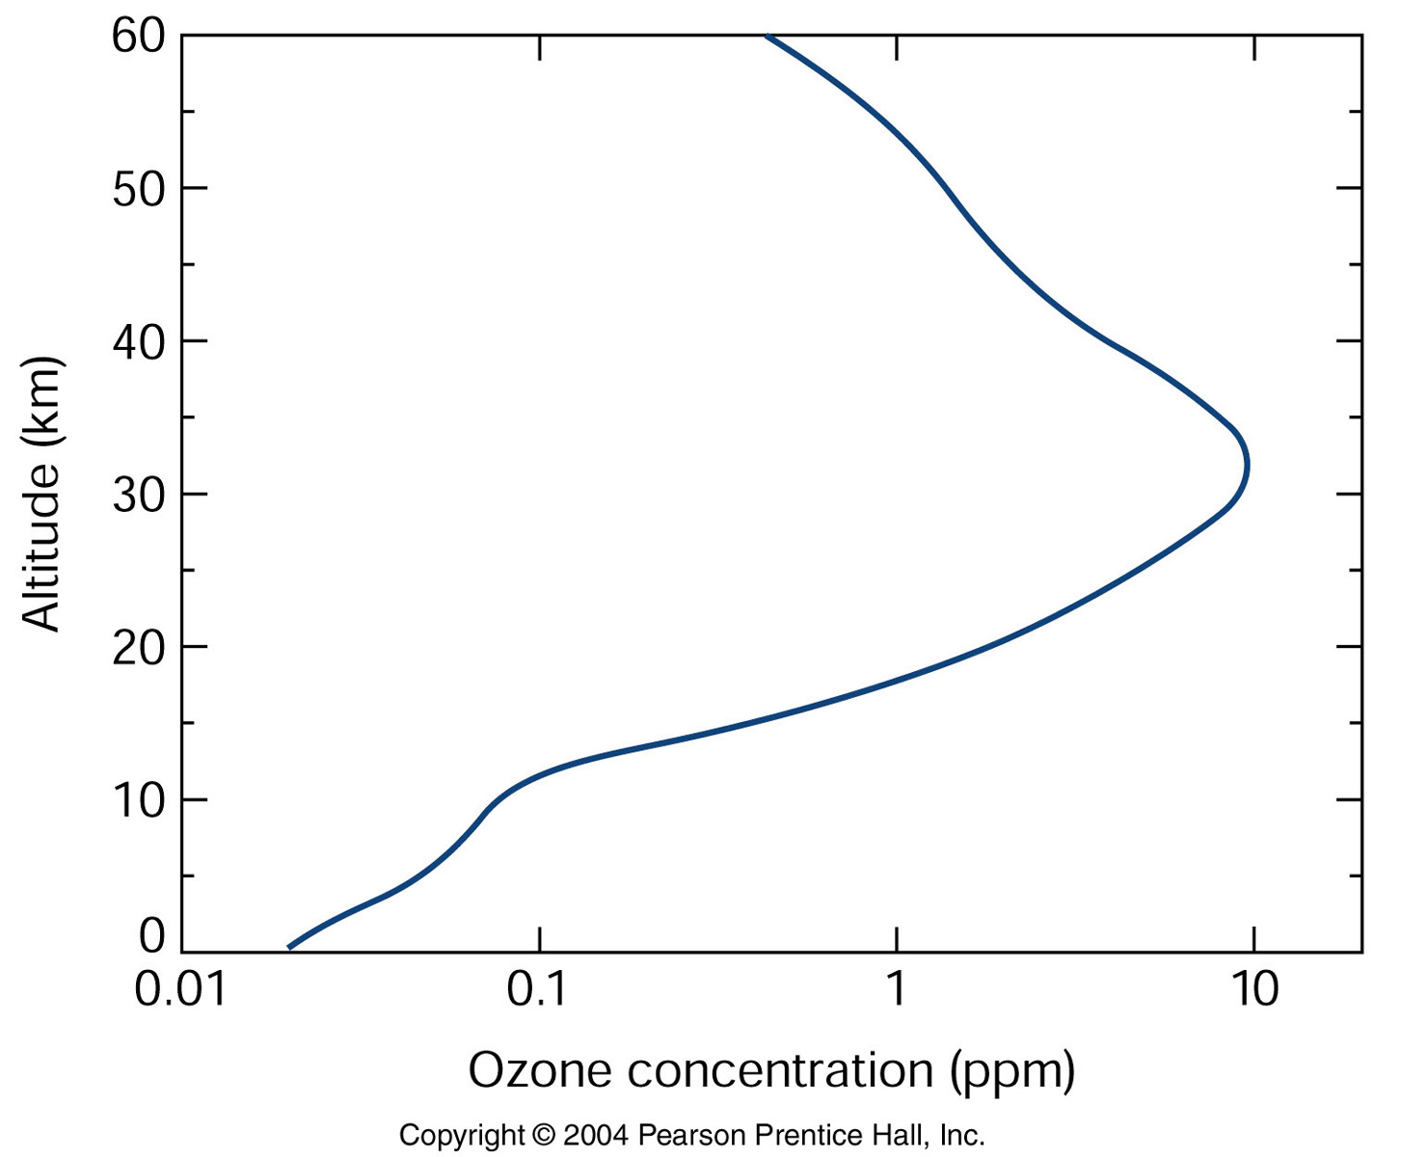
Atmospheric temperature structure
Troposphere: nearly uniform potential temperature so temperature drop with height is nearly adiabatic
Stratosphere is warmest at top: due to absorption of the sun’s UV radiation. (The ozone maximum is in the middle of the stratosphere.)
Also see http://earthguide.ucsd.edu/earthguide/diagrams/atmosphere/index.html
Kump, Kasting, Crane (2004) textbook

Slide 14
Adiabatic lapse rate and potential temperature
Air is compressible (much more so than water). Thus the effects of compressibility on temperature are much the same as we’ve already learned for the ocean.
Adiabatic lapse rate Γ:
Γ_{d} = -(dT/dz)_{dry parcel} = g/c_{p}
where subscript d = dry, using the 1st law of thermodynamics to relate temperature and pressure change, and then using hydrostatic balance.
In dry atmosphere, adiabatic lapse rate is 9.8 °/km
In moist atmosphere, adiabatic lapse rate is 6 to 7 °/km
Potential temperature: reference level is the ground, taken as 1000 mbar.
Notes:
Rho Cp dT = rho g dz from hydrostatic balance and definition of specific heat relating dp to dT
dp = -rho g dz (hydrostatic)
PdV = dQ (1st law of thermodynamics if internal energy is constant, dQ is heat energy)
dp = rho c_p dT (combine)

Slide 15
Winds
Winds are forced mainly by heating from the earth’s surface below.
Air rises in warmer locations.
(As it rises, if over the ocean, it tends to carry moisture and cause precipitation.)
Because it has much higher specific heat, water temperature varies much more weakly with given surface heat flux than does land (since dirt includes both water and lower-specific-heat air).
With diurnal or seasonal forcing of adjacent land and sea, the sea temperature varies a little and the land temperature varies a lot. This creates diurnal or seasonal reversals of locations of rising air in the atmosphere (“seabreeze” and “monsoon”)
“Direct circulation”: wind (or current) blowing from high to low pressure

Slide 16
Direct circulation
“Direct circulation”: wind (or current) blowing from high to low pressure. Rotation effects are either negligible or relatively unimportant
Examples presented here:
Diurnal winds (sea and land breeze, driven by land-sea temperature contrast)
Monsoonal winds (seasonal, driven by land-sea temperature contrast in the tropics where rotation is a minor factor)
Walker circulation (permanent, equatorial atmospheric circulation driven by zonal SST contrast)

Slide 17
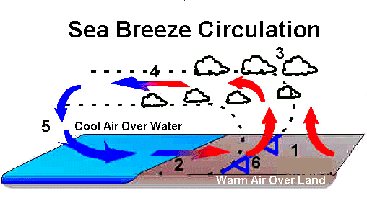
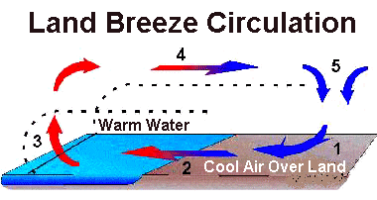
Wind response to differential heating: Diurnal - Land and sea breeze
Diurnal cycle of heating and cooling
Land temperature extremes are much larger than ocean temperature extremes through the daily cycle (because the specific heat of water is so high compared with air and dirt)
Hot-cold contrast creates upward convection in the air above the warm area (land in the day, ocean in the night), and sinking over the cooler area

Slide 18
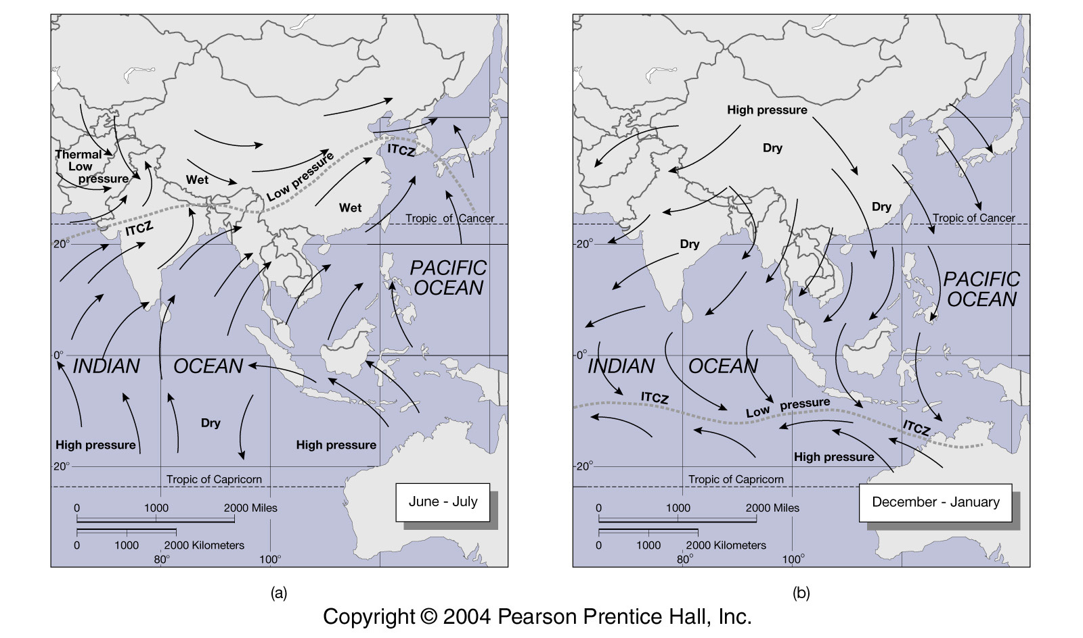
Wind response to differential heating: Seasonal - Monsoons
Same idea as diurnal sea breeze: ocean seasonal temperature range is much smaller than land seasonal temperature range. Rising air over warmer area and sinking over cooler, modified by Coriolis deflection
“Direct circulation” driven by differences in heating and cooling
WARM
COLD
Northern hemisphere summer
Northern hemisphere winter
Kump, Kasting, Crane (2004) textbook

Slide 19
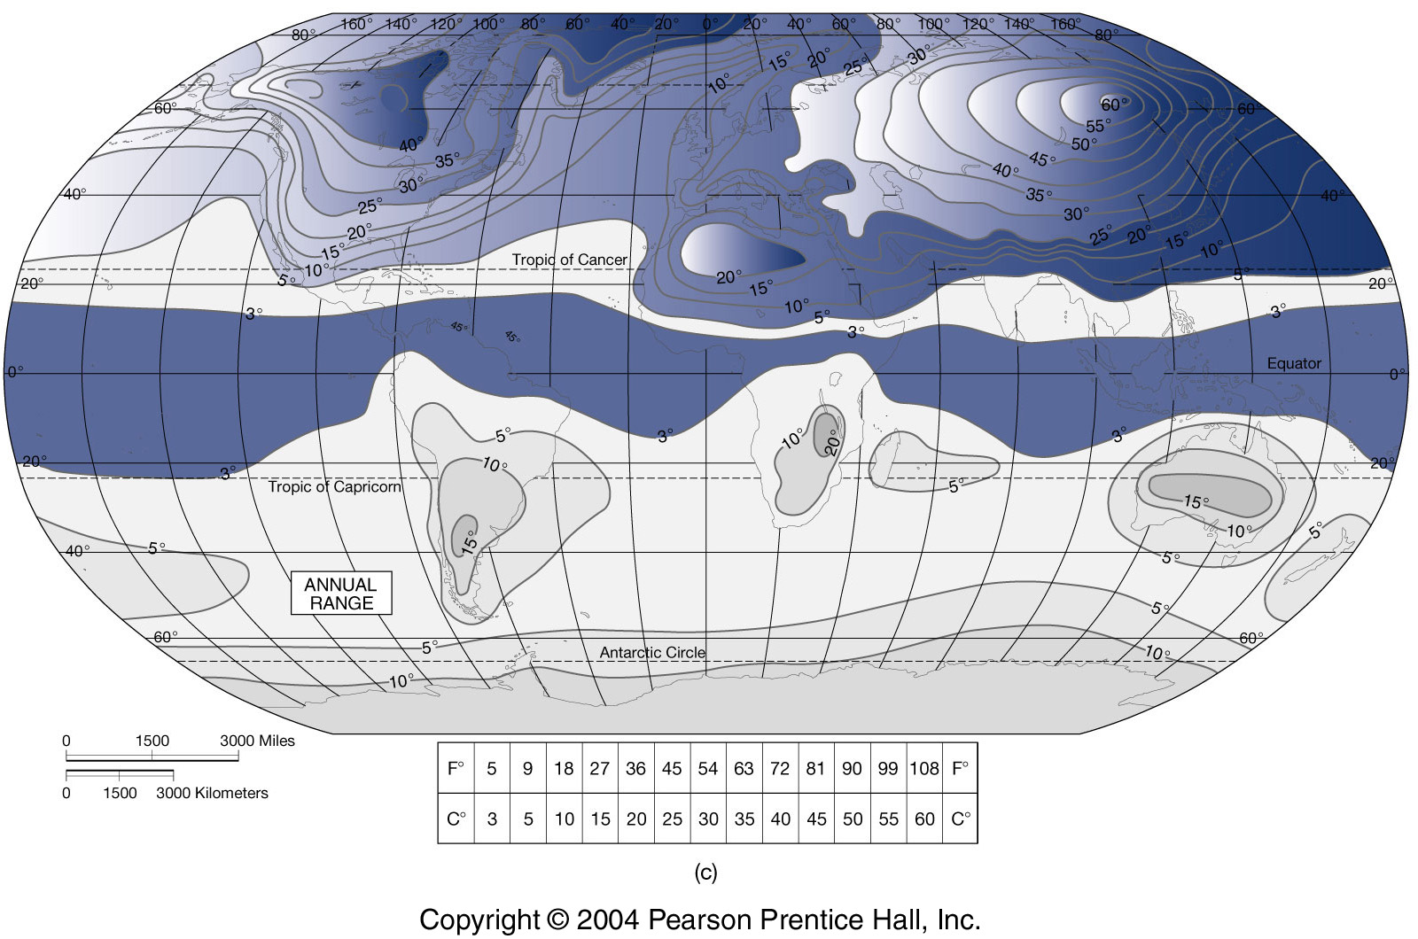
Annual range of surface temperature (°F)
Kump, Kasting, Crane (2004) textbook

Slide 20
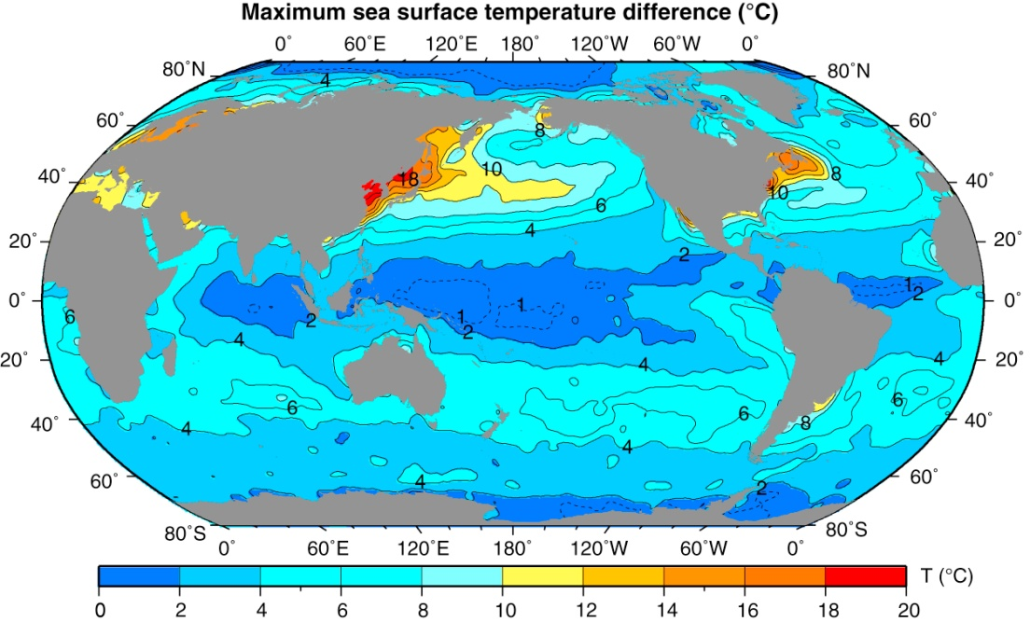
Can see that monsoon is not driven by the SST annual range in the Arabian Sea– has to be the land annual range. Monsoon: SST remains relatively constant while land temperature goes through large annual cycle.
Annual range of sea surface temperature (°C), based on monthly climatological temperatures from the World Ocean Atlas (WOA05) (NODC, 2005a, 2009).
DPO Fig. 4.9
Notes:
Can see that it is not the SST annual range in the Arabian Sea that drives the monsoon – has to be the land annual range. Monsoon: SST remains relatively constant while land temperature goes through large annual cycle.

Slide 21
Monsoons (seasonal)
WARM
COLD
Jun-Aug (SW monsoon)
Dec-Feb (NE monsoon)

Slide 22
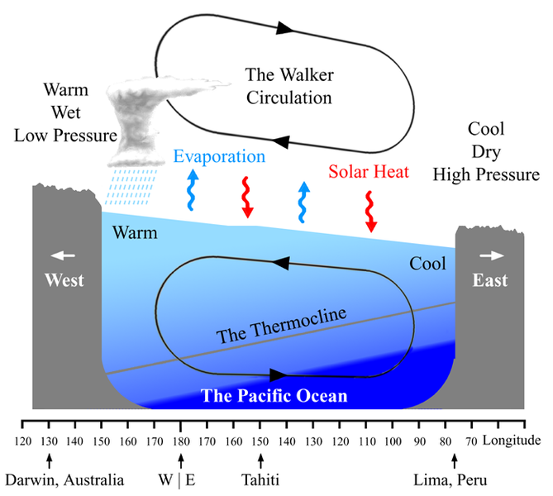
Equatorial winds: Direct atmospheric circulation Walker circulation: (Coriolis not important as f ~ 0)
“Bjerknes feedback” between the ocean and atmosphere.
Warm water causes air to rise, creates wind, that sets up currents, that causes SST contrast.

Slide 23
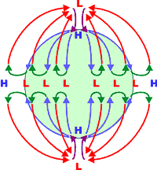
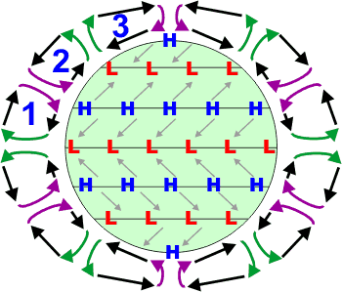
Mean large-scale wind and pressure structure Convection and subsidence, in response to global heating and cooling
What we might expect from global heating and cooling
What we actually have - 3 cells - due to rotation
1. Hadley 2. Ferrel 3. Polar

Slide 24
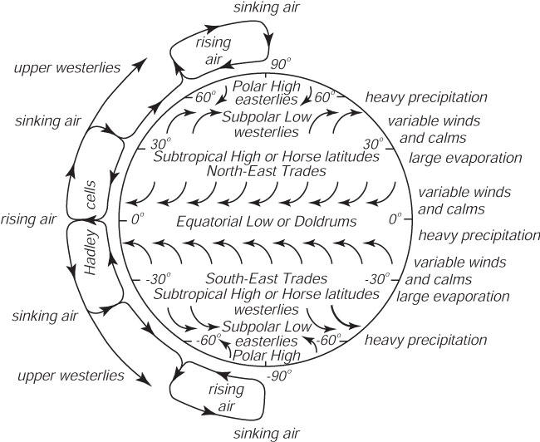
Meridional view of global winds
Sinking air
Rising air
Subsidence
ITCZ
Stewart Fig. 4.3

Slide 25
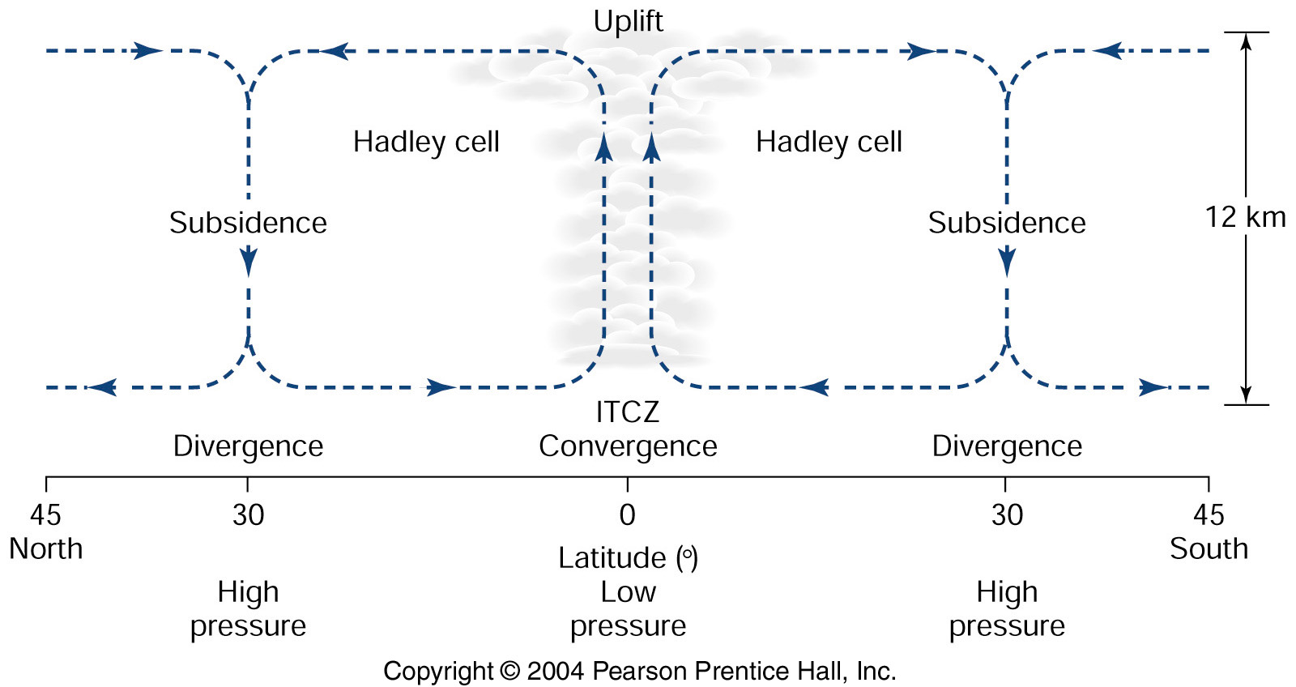
1. Hadley cell
ITCZ = Intertropical Convergence Zone
Actually not exactly on equator: seasonal variations in insolation, so ITCZ sits at maximum heating location.
ITCZ is well developed north of equator (because of land distribution).
Subsidence at about 30 °N, S
Kump, Kasting, Crane (2004) textbook
Notes:
Also there is usually colder water on the equator due to upwelling (at least in Pacific), which means that the ITCZ(s) are located permanently off the equator

Slide 26
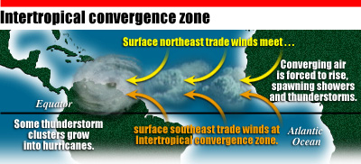
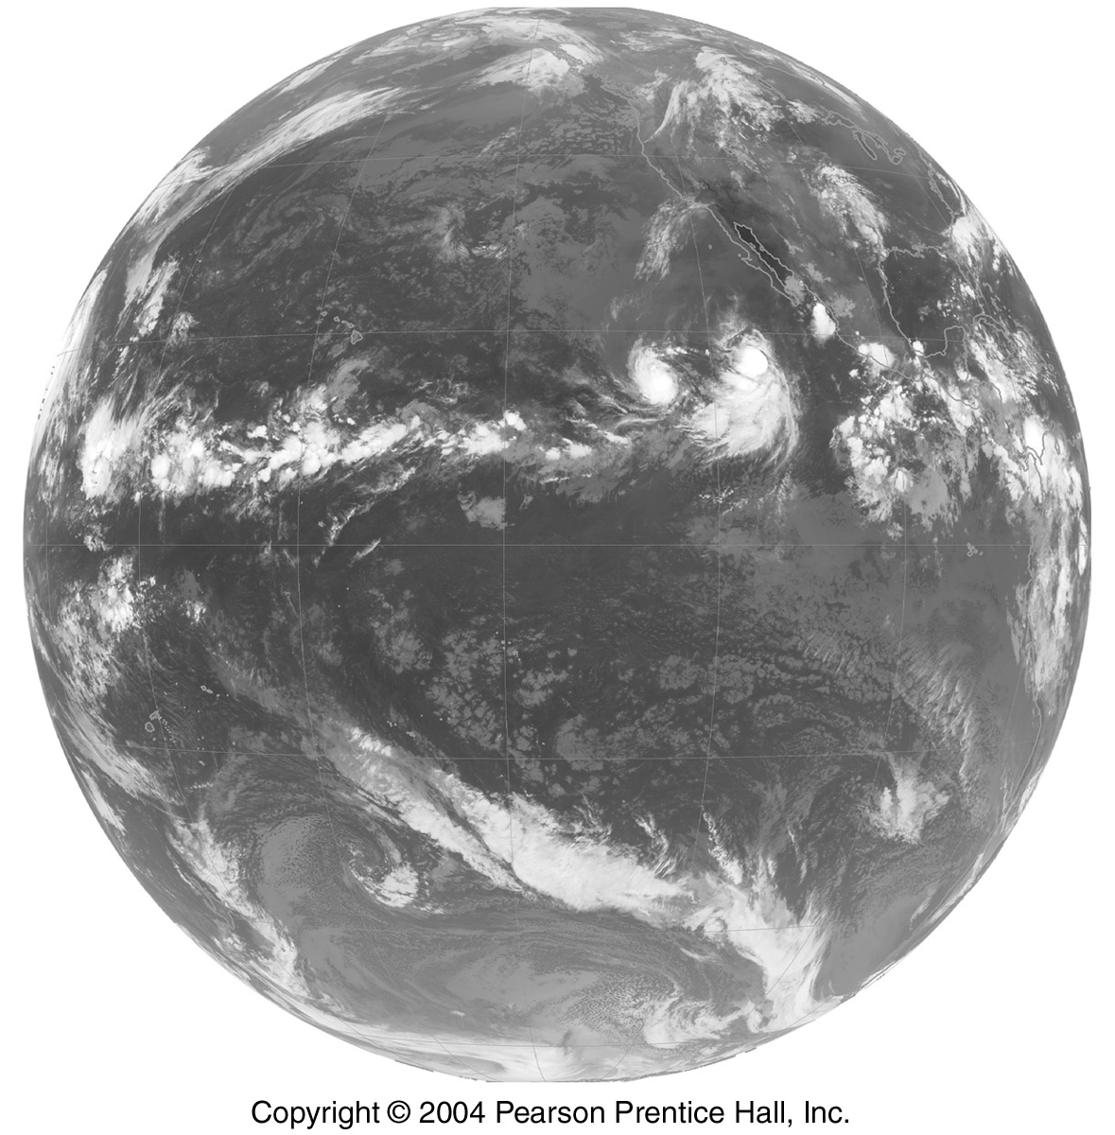
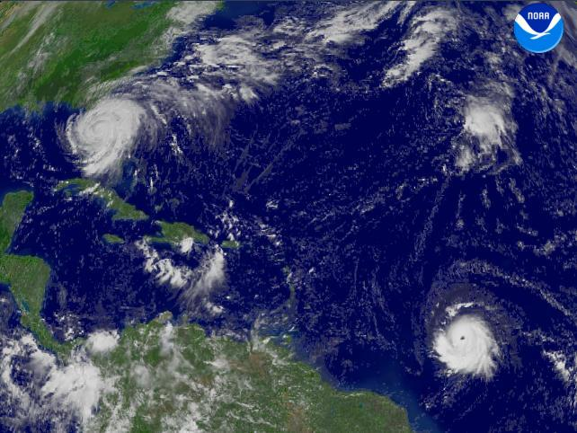
Intertropical Convergence Zone
Atlantic Ocean 9/04
Pacific Ocean
ITCZ spawns hurricanes
Notes:
Nice animation at http://www.gerhards.net/astro/wolken_200705_en.html
http://www.gerhards.net/astro/wolken_200705_full.html

Slide 27
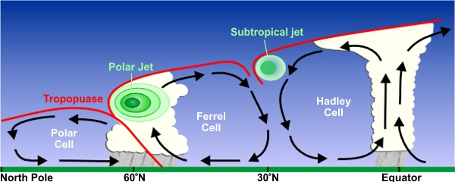
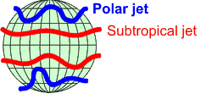
The three cells and the jet streams: Polar and Subtropical Jets
Polar easterlies Westerlies Trades (easterlies)
Notes:
Polar and Subtropical Jet are both westerlies.
Polar Jet is what we often refer to as the “jet stream”, brings storms (see Wikipedia), but both are “jet streams”
Subtropical Jet Stream is due to the upper part of the Hadley cell, which turns eastward as it moves poleward and forms the jet
Wikipedia on Ferrel cell – “ball bearing” between the hadley and polar cells; surface westerlies are really a series of storms through which the westerly wind is the average. Upper part of F.C. is not really continuous – connects variously with the Hadley and polar cells.
Not clear why polar jet is located where it is (frm what I’ve read thus far).

Slide 28
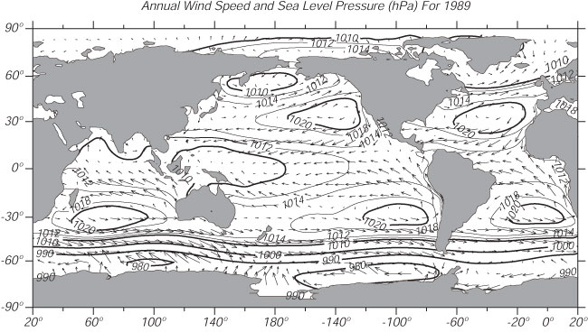
Annual mean surface winds and surface pressure
LOW
LOW
WESTERLIES
HIGH
HIGH
LOW
TRADE WINDS
HIGH
HIGH
HIGH
WESTERLIES
LOW

Slide 29
Wind stress
Wind stress drives the ocean (waves, currents).
Transfer of momentum from wind to ocean.
Wind speed is measured above the sea surface. In practice measurements are at different heights. For consistency, adjust all measurements to a 10 meter height.
Actual stress on the ocean:
τ = c_{D}ρu²
where u is the wind speed at 10 meters, ρ is the air density 1.3 kg/m³, and c_{D} is the (dimensionless) drag coefficient, which is determined empirically.
Units of wind stress: Newton/m²
(check this using density times velocity squared)
Notes:
Units of wind stress: Newton/m2 or dyne/cm2
From kg/m^3 times (m/sec)^2 = kg/(m sec^2)

Slide 30
Wind stress and wind speed
Wind stress is the force per unit area exerted by the wind on the ocean
Stress τ = ρc _{D} u₁₀ ² in units of N/m² (or dynes/cm²)
Where u₁₀ = wind speed at 10 m height
ρ is air density 1.3 kg/m³
c _{D} is a “drag coefficient” (dimensionless)
At low wind speeds, c _{D} ≈ 1.1 x 10⁻³
At higher wind speeds, c _{D} ≈ (0.61 + 0.063 u) x 10⁻³
COARE 3.0 algorithm Fairall et al. (J. Climate 2003)
Stewart section 4.5

Slide 31
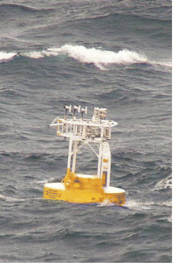
Wind stress continued
Most recent drag coefficients “COARE 3.5” determined from direct measurements, including high wind speeds
[At low wind speed c_{D}~ 1.1 x 10⁻³]
Edson et al. (JPO, 2013)

Slide 32
(Older) COARE 3.0 algorithm, drag coefficient
Kara et al. (J. Clim. 2007)

Slide 33
Surface wind stress (northern summer)
Average wind speeds up to 10 m/sec (factor of 10 greater than ocean current speeds)
Note westerlies and trades
Monsoonal winds in Indian Ocean
Look for monsoons in other tropical locations
DPO Fig. 5.16a

